Slide 1
Effective Division Meetings
Re-name Yourself in Zoom
(include your role)
Example: DD Sandy Chen
For Technology Support
Chat with Zoom Master

Slide 2
Effective Division Meetings
Session #
Please “re-name” yourself to include your role
(Example: DD Sandy Chen)
Receive Session Workbook in chat

Slide 3
Agenda
Effective Division Meetings
What’s Wrong with Meetings?
Meeting Best Practices

Slide 4

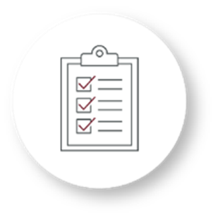
Identify
Develop
Identify barriers and best practices to having effective meetings
Develop strategies to conduct effective meetings

Slide 5

What’s Wrong with Meetings?

Slide 6
Breakout Room Activity:
What’s Wrong with Meetings

Slide 7

Breakout Room Tips
Click “Join Breakout Room” button
Use Zoom tools as needed (Share Screen, Annotate, Whiteboard)
Assign a Timekeeper
Watch for Broadcast and Chat messages
Use “Ask For Help” button
Join Breakout Room

Slide 8
What’s Wrong with Meetings? Activity Instructions
  Join your team in a breakout room (automatic)
  Using your Session Workbook, brainstorm and list what makes a meeting ineffective. Then determine the impact of each item on your list.
  You will have 10 minutes
  Start on page 2 in your Session Workbook

Slide 9
What was one thing you discussed as being ineffective during a meeting?

Slide 10
Seven Shortcomings of Meetings
People don’t take meetings seriously.
Meetings are too long.
People wander off the topic.
Nothing happens once the meeting ends.
People don’t tell the truth.
Critical decisions are postponed.
People make the same mistakes and meetings never get better.
Adapted from: Fastcompany.com

Slide 11
Review: What’s Wrong With Meetings
Be aware of the seven shortcomings of meetings
Strategically plan your meetings

Slide 12

Meeting Best Practices

Slide 13
Breakout Room Activity:
Meeting Best Practices

Slide 14
Breakout Room Tips
Click “Join Breakout Room” button
Use Zoom tools as needed (Share Screen, Annotate, Whiteboard)
Assign a Timekeeper
Watch for Broadcast and Chat messages
Use “Ask For Help” button
Join Breakout Room

Slide 15
Meeting Best Practices Activity Instructions
  Join your team in a breakout room (automatic)
  Using your Session Workbook and the information from “Seven Shortcomings of Meetings”, brainstorm best practices for addressing your assigned shortcoming. Then complete the questions to consider.
  You will have 15 minutes
  Start on page 3 in your Session Workbook

Slide 16
What was your top best practice you discussed to address your shortcoming?

Slide 17
Review: Meeting Best Practices
Design meetings with best practices in mind
Continue to reflect on ways to make your meetings more effective and implement changes

Slide 18
Conclusion
Effective Division Meetings
What’s Wrong with Meetings?
Meeting Best Practices

Slide 19
Share one insight from this session that you will apply during your next meeting

Slide 20
Session Assessment
Go to link in Chat
You will have 5 minutes

Slide 21
[Insert text]

