Slide 1
So You’ve Joined Toastmasters. Now What?
New Member Orientation
Notes:
(Note for presenter: This presentation is designed to be customized to fit your club’s preferences and outline how Toastmasters can meet your new member’s specific goals. We recommend you read through the entire presentation, update any text in brackets, and have the new member fill out the New Member Profile before orienting them. This presentation is designed to be delivered by the new member’s mentor. If they have not been assigned a mentor, a club officer may present it.)

Slide 2
Agenda
Your goals
Club meeting roles
The Toastmasters Pathways learning experience
Mentoring
Leadership opportunities
Next steps
Member support and club expectations
Notes:
Today, we will:
Start by talking about your goals and get an understanding of what you want out of Toastmasters.
Then we will outline the club meeting roles and suggest one for you to start with.
We will move into Toastmasters' education program, the Toastmasters Pathways learning experience.
After that, we can talk about mentoring and how [I/your mentor] can help you on your journey.
Next, we will talk about the leadership opportunities available to you.
When we are done with that, we can talk about what your next steps are.
Finally, we will talk about how our club is here to support you and what we ask of our members.

Slide 3
What are your goals?
Our objective is to help you meet your goals.
Per the New Member Profile you completed, your goals are:
  [_________________________________]
  [_________________________________]
Return
Notes:
Let us start our journey by discussing your goals. Our goal is to help you meet your goals.
(Note for presenter: We suggest having the new member fill out the New Member Profile before walking them through this presentation. If they have not, simply ask them what their goals are and what they hope to accomplish through Toastmasters. If they did fill out the New Member Profile, add their goals to this slide so you can reference them at any time.)

Slide 4

How can we support you?
Is there anything specific you want us to do to help you meet your goals?
Do you want to set your own timeframes, or do you want us to nudge you to participate?
Notes:
What can we do to help you meet your goals? Everything in Toastmasters revolves around the club experience. To get the most out of your journey, you must participate. You can do so by taking part in Table Topics, filling meeting roles, giving speeches, and more. Would you like to set your own timeframes, or do you want our support in suggesting when to participate?

Slide 5
Club meeting roles
Each meeting role has a unique set of responsibilities and skills for you to explore.
[Information about how to sign up for roles in your club]
Based on your goals, roles that I recommend are:
Toastmaster
Grammarian
Ah-Counter
Timer
Table Topics® Speaker
Topicsmaster
Speaker
Evaluator
General Evaluator
Return
Notes:
Each club meeting has nine meeting roles that are filled by members. Each role has a unique set of responsibilities and skills that can be gained by filling them.
(Note to presenter: Edit this slide with information about the process for a member to sign up for a role in your club. Then take some time to outline the process for them, as well as a recommended role they can start with that matches their goals. While you do not have to, it is a good idea to outline all nine roles so a new member understands the structure of a meeting.
When you introduce Table Topics, we recommend covering the Table Topics Speaker role and then Topicsmaster.)

Slide 6

Toastmaster
We recommend waiting until you have observed a few meetings.
Resources:
  A Toastmaster Wears Many Hats
  Master Your Meetings
  Toastmaster of the Day Script
  and Log
Serving as Toastmaster is an excellent way to practice planning, organization, time management, facilitation, motivation, and team-building skills.
Return
Notes:
The Toastmaster is the meeting's director and host. We typically do not recommend filling this role until you are thoroughly familiar with the club and its procedures. As Toastmaster, you:
Acquire a meeting agenda from your Vice President Education.
Work with the General Evaluator to ensure all club participants know their roles and responsibilities.
Introduce participants during the club meeting, including speech topics, project title, objectives, delivery time, etc. during your introduction.
Ensure the meeting runs smoothly, including seamless transitions between meeting segments.

Slide 7
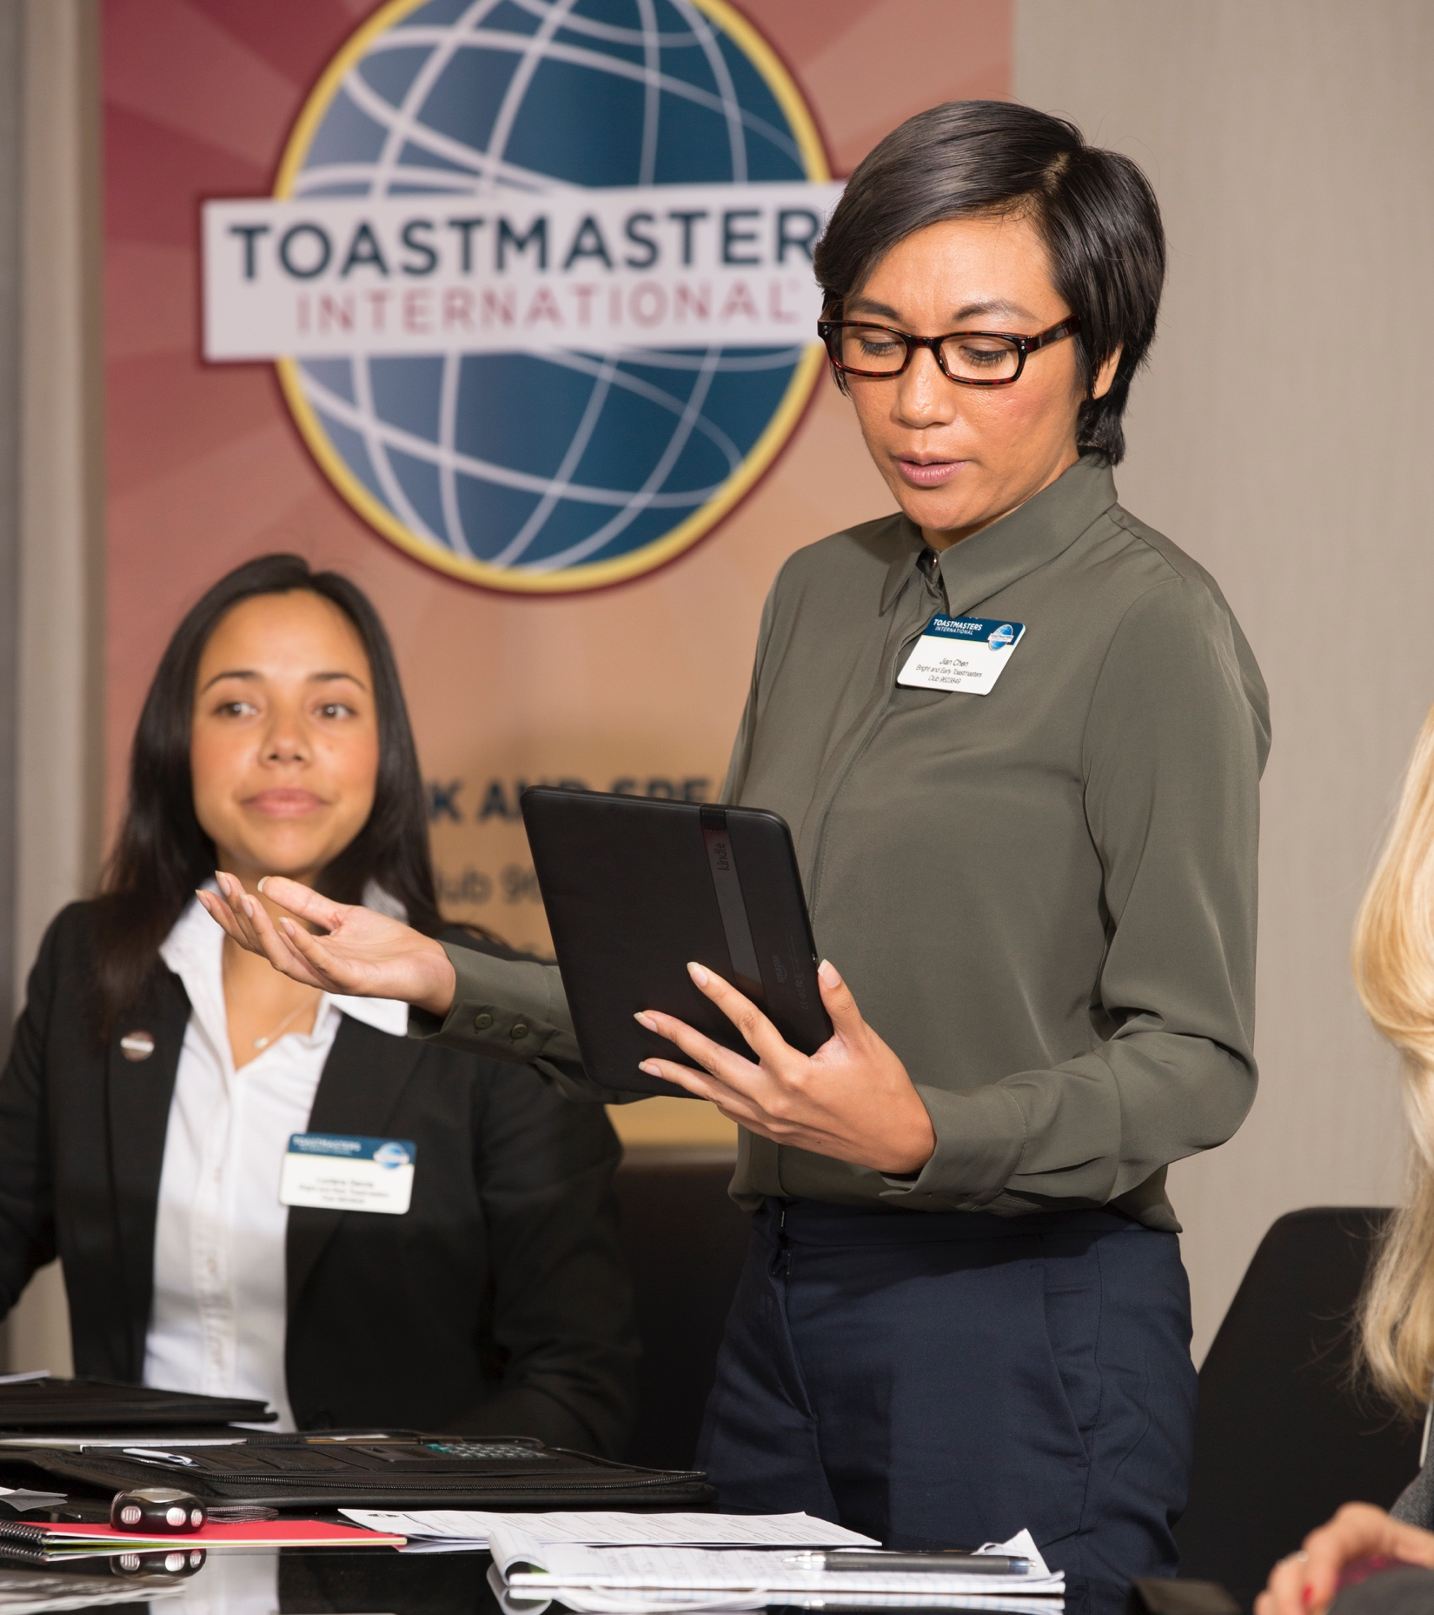
Grammarian
This is a good role to start with.
Resources:
  A Toastmaster Wears Many Hats
  Word of the day
  Grammarian Script and Log
Skills practiced as grammarian include planning, evaluation, interpersonal communication, and public speaking.
Return
Notes:
The grammarian plays an important role in helping all club members improve their grammar and vocabulary. As grammarian you:
Introduce new words to meeting participants and monitor language and grammar usage
Take note of both exceptional and improper grammar.
Report your observations when called upon.
(Note for presenter: only include the following if applicable to your club.) Introduce a "Word of the Day" that helps meeting participants increase their vocabulary.

Slide 8

Ah-Counter
This is a good role to start with.
Resources:
  A Toastmaster Wears Many Hats
  Ah-Counter Script and Log
This role works on skills of active listening, evaluation, and providing effective feedback.
Return
Notes:
The purpose of the Ah-Counter is to note any overused words or filler sounds used by anyone who speaks during the meeting. Words may be inappropriate interjections, such as and, well, but, so, and you know. Sounds may be ah, um, or er. As Ah-Counter you:
Give a brief explanation of the role when introduced during the club meeting.
Record overlong pauses, overused words, and filler sounds.
Report your observations when called upon.

Slide 9
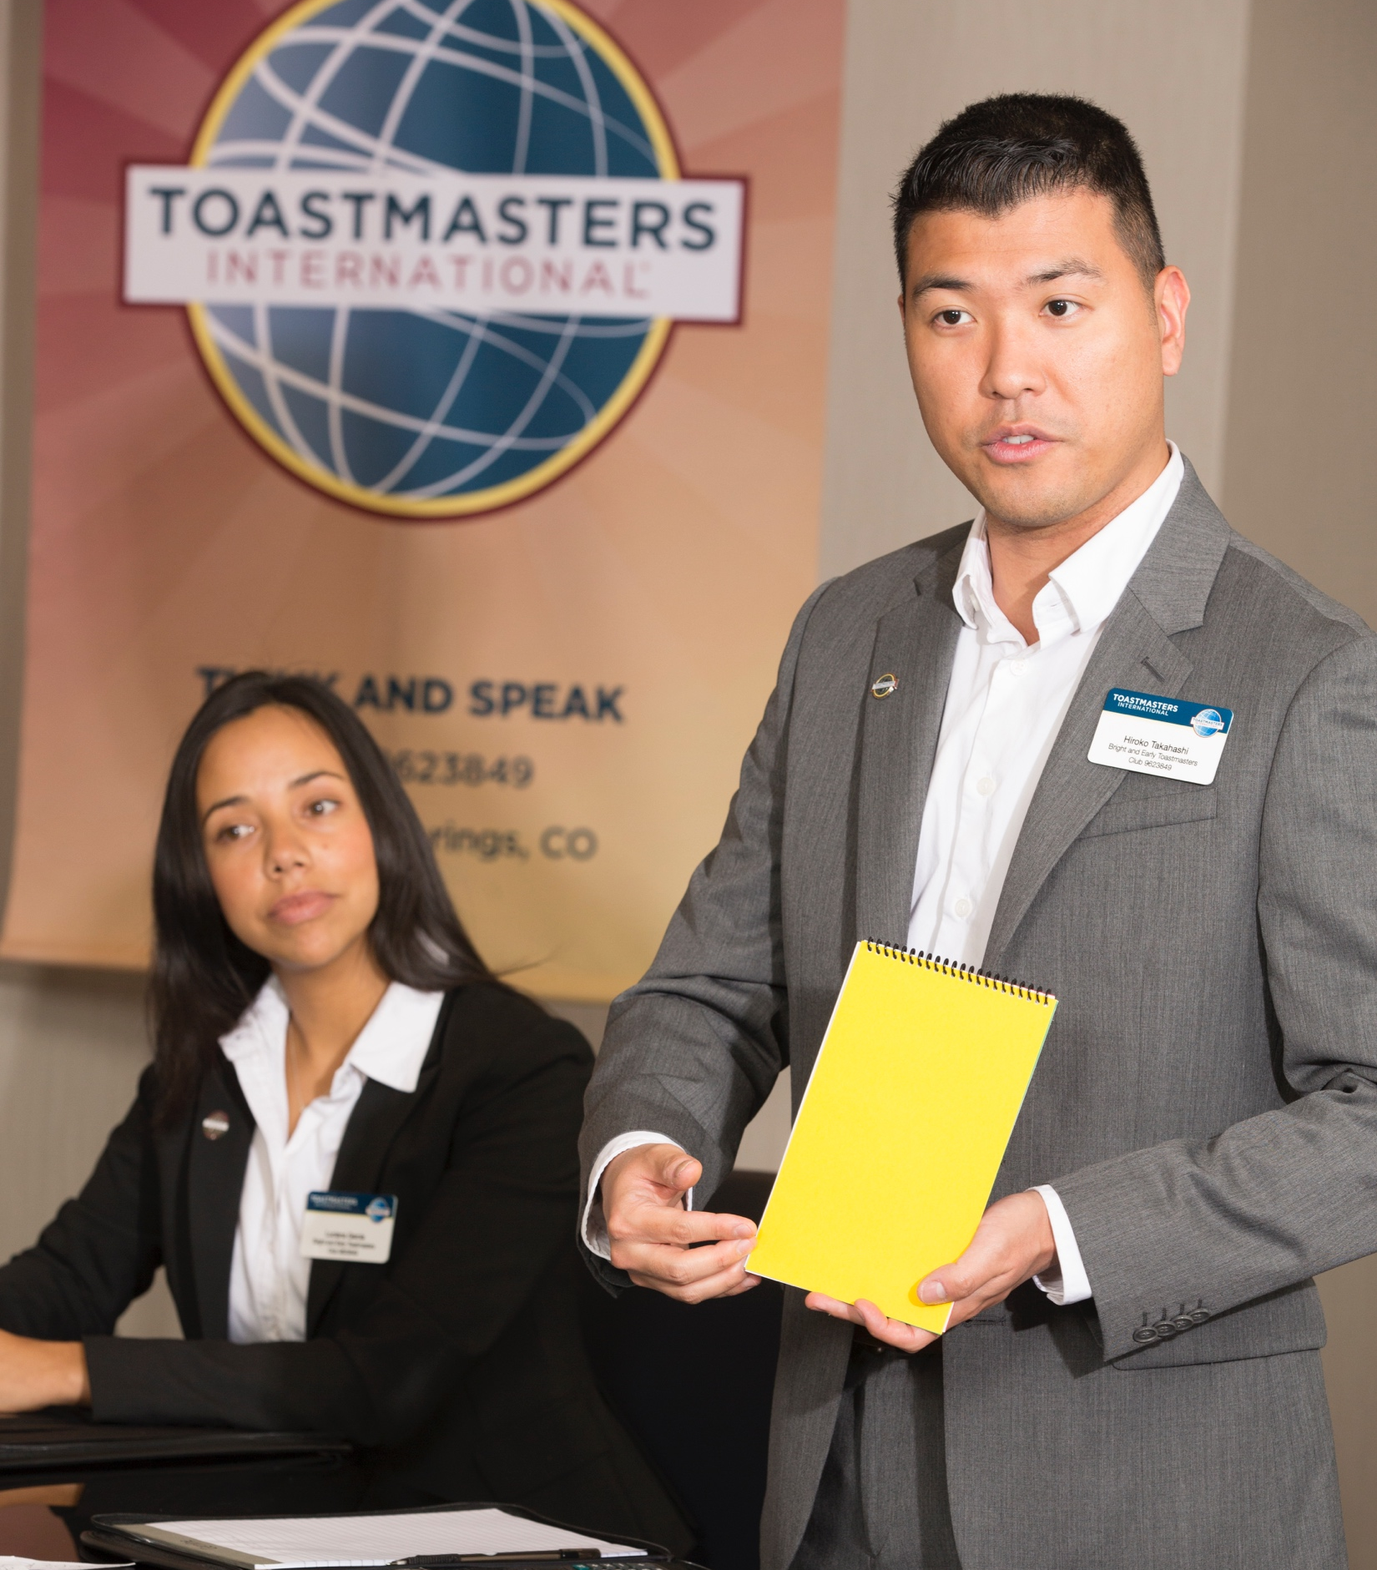
Timer
This is a good role to start with.
Resources:
  A Toastmaster Wears Many Hats
  Timing Cards
  Timer Script and Log
The timer role builds skills of organization, time management, active listening, and leadership.
Return
Notes:
One of the skills Toastmasters practice is expressing a thought within a specific time. The timer is responsible for monitoring time for each meeting segment and each speaker. As timer, you:
Acquire the timing/signaling equipment from the Sergeant at Arms and know how to operate it.
Explain the timing rules and demonstrate the signaling device.
Listen carefully to each participant and signal them accordingly.
Announce the speakers' names and the time taken.
Return the timing/signaling equipment to the Sergeant at Arms.

Slide 10
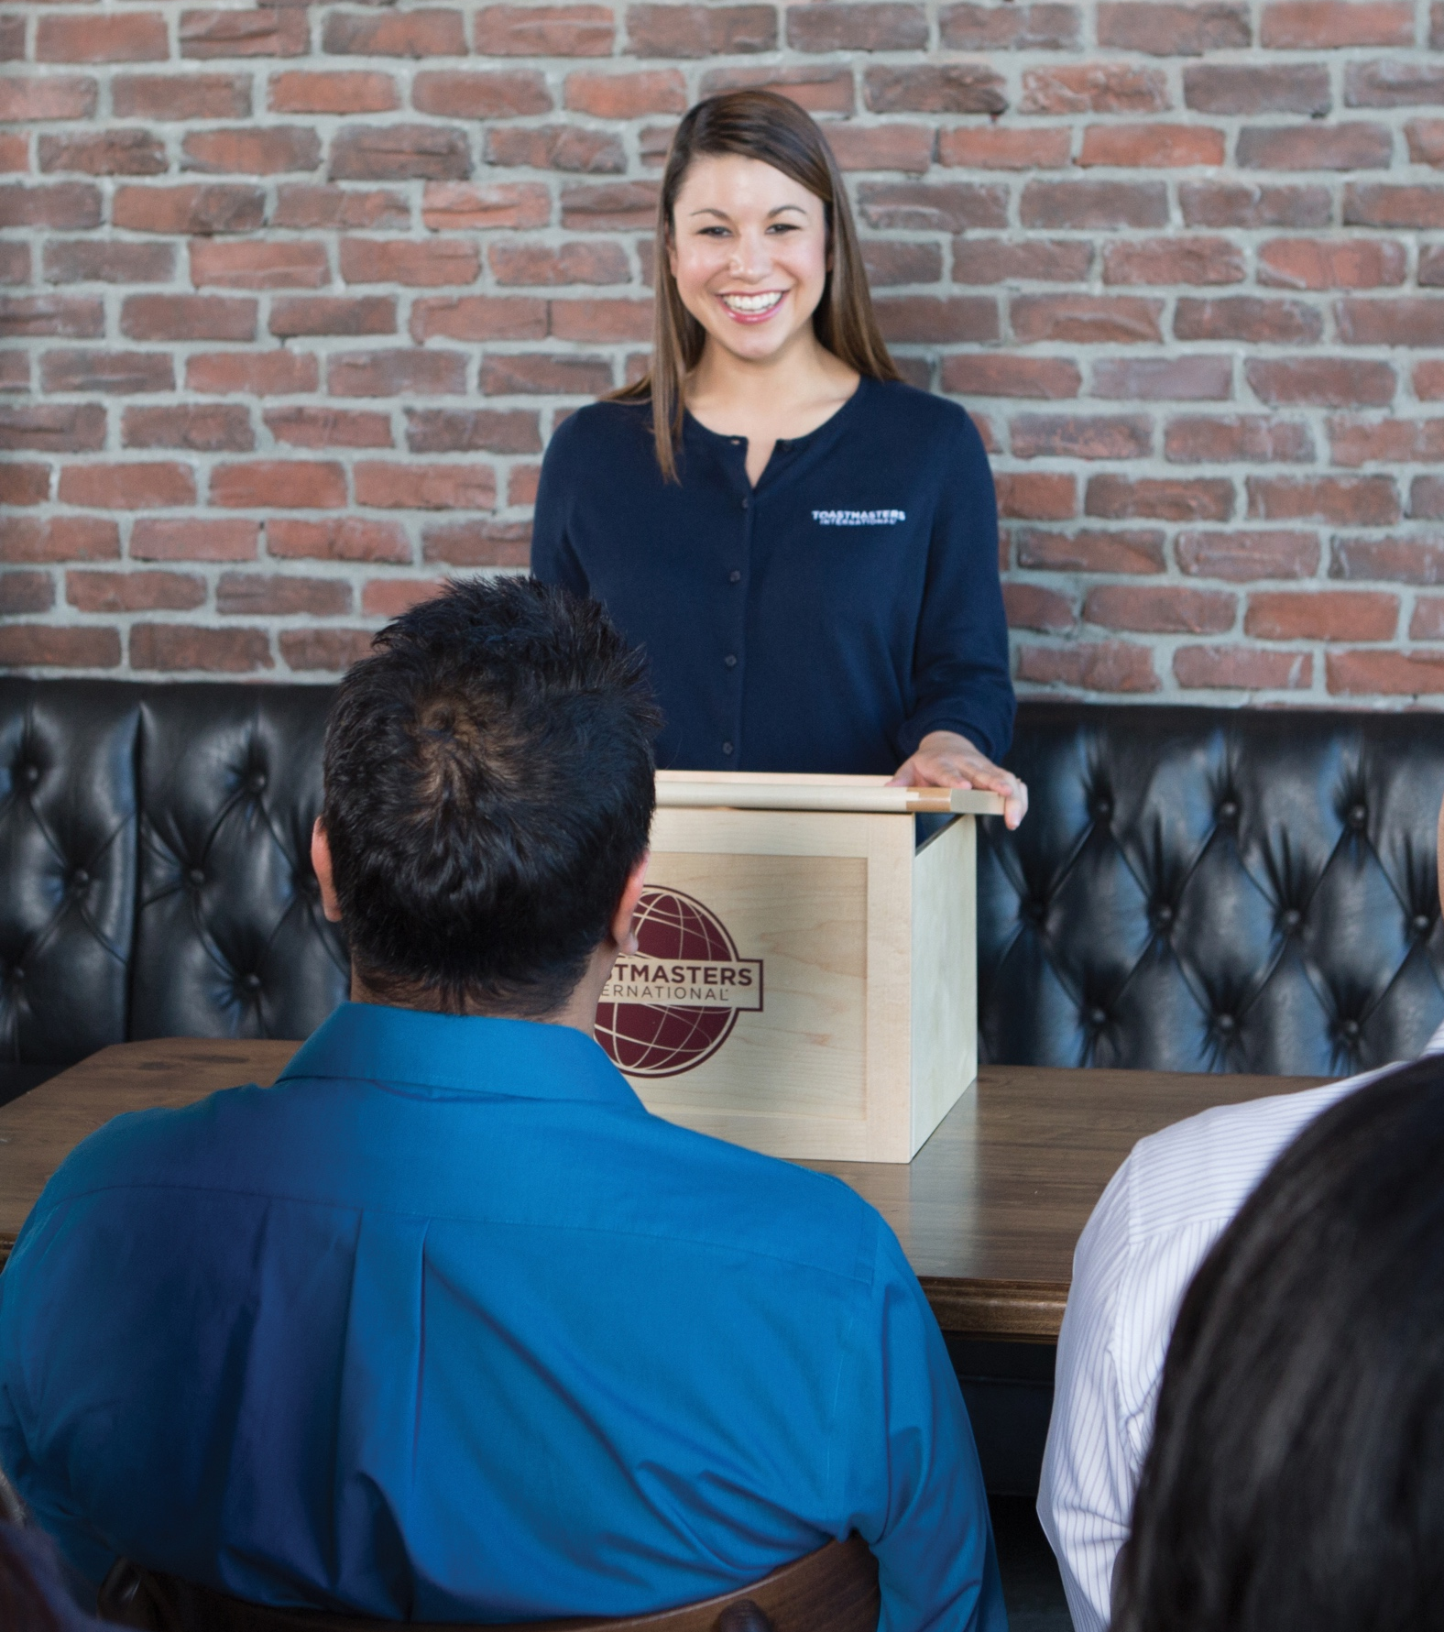
Table Topics® Speaker
Join in at any time.
Pass if you are not ready.
This role practices organizing thoughts, delivering concise impromptu speeches, and time management.
Return
Notes:
(Note to presenter: We recommend starting with this slide before explaining the Topicsmaster role.)
Table Topics helps train members to quickly organize and express their thoughts in an impromptu setting. It typically begins after the prepared speech presentations. The Toastmaster will introduce the Topicsmaster, who will give a brief description of Table Topics and then call on respondents at random. Responses should be clear and succinct, lasting one to two minutes. We recommend you start your Toastmasters journey as a Table Topics Speaker.

Slide 11

Topicsmaster
We recommend waiting until you have observed a few meetings.
Resources:
  A Toastmaster Wears
  Many Hats
  TableTalk
  Master Your Meetings
  Topicsmaster Script and Log
  As Topicsmaster, skills practiced are leadership, planning, time management, and motivation.
Return
Notes:
When you are more comfortable, you may take on the Topicsmaster role.
As Topicsmaster, you:
Select topics in advance of the meeting that allow speakers to offer opinions.
Assign topics to members who are not assigned a meeting role.
Ask members to vote for the best Table Topics® speaker.

Slide 12
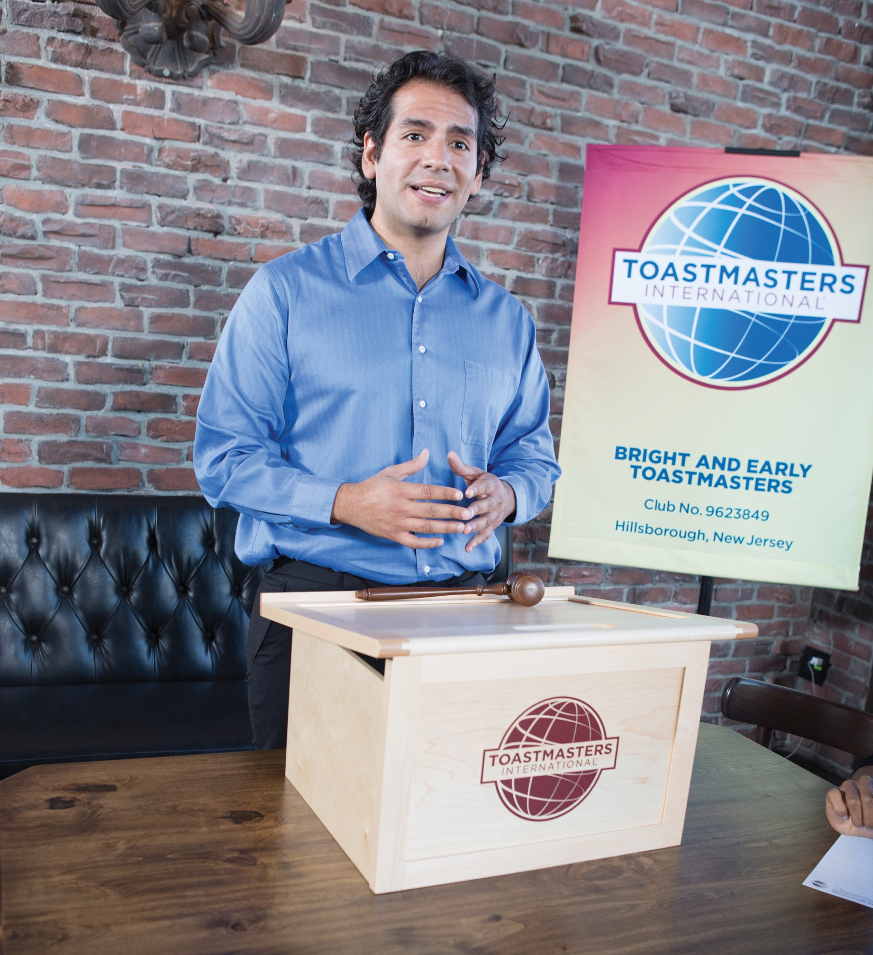
Speaker
We usually recommend delivering your first speech in the first [timeframe] of your membership.
Resources:
  Your Pathways path
  Public Speaking Tips
  Speaker Introduction Form
  This role practices planning, preparation, time management, and public speaking skills.
Return
Notes:
(Note for presenter: Update the slide to outline when you recommend a speaker give their Ice Breaker.)
Serving as a speaker provides you with an opportunity to develop your public speaking skills. It is also an educational opportunity for your club. As a speaker, you:
Prepare, rehearse, and present a speech during the club meeting.
Discuss your goals, strengths, and weaknesses with your evaluator prior to giving your speech.
Receive feedback from your evaluator to implement in future speeches.

Slide 13
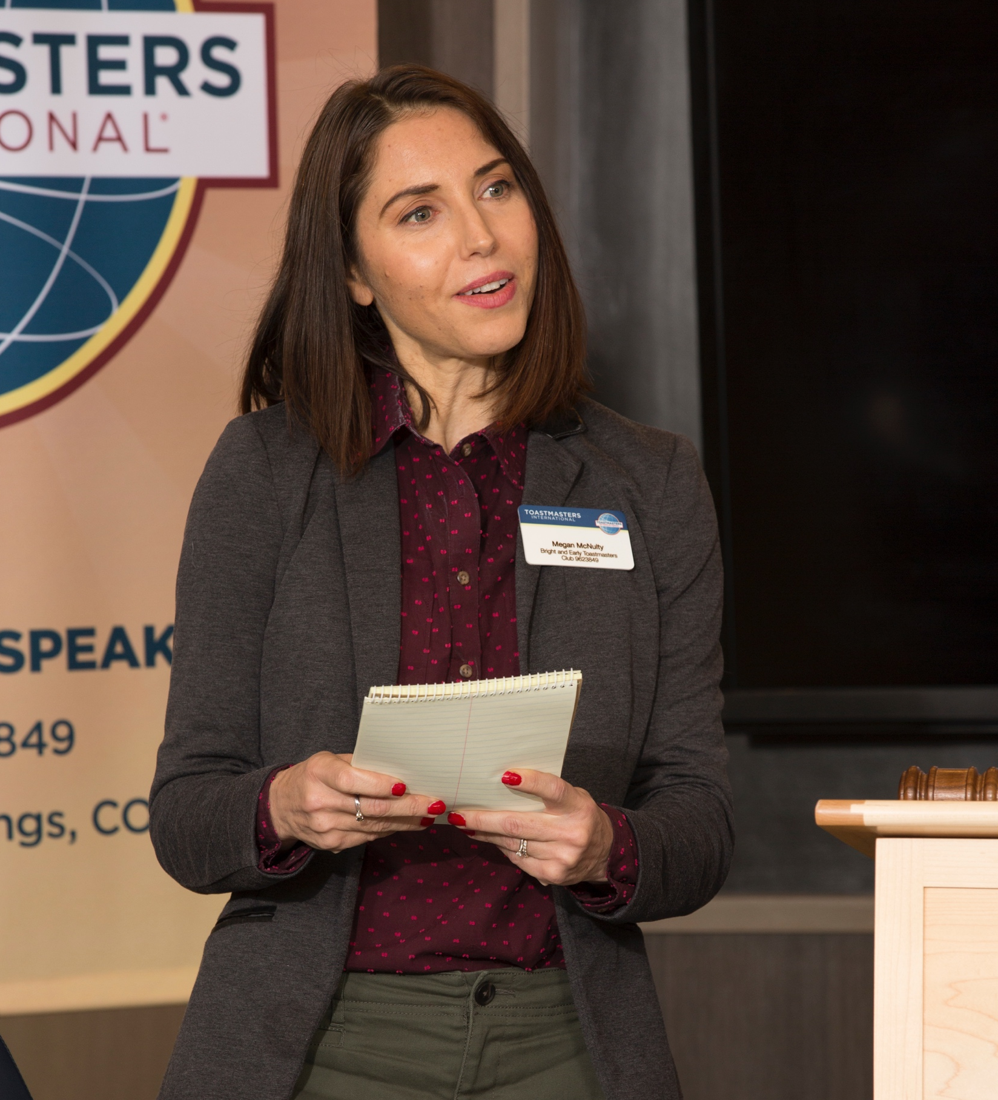
Evaluator
We recommend waiting until you have observed a
few meetings.
Resources:
  A Toastmaster Wears
  Many Hats
  Effective Evaluation
  As evaluator, skills practiced are listening, critical thinking, providing feedback, and motivation.
Return
Notes:
Evaluation is the heart of the Toastmasters educational program. You observe the speeches and leadership roles of your fellow club members and offer evaluations of their efforts, and they do the same for you. As evaluator you:
Ask those you have been assigned to evaluate what they will present and what they wish to achieve.
Provide objective verbal and written evaluations for speakers.
Offer praise as well as constructive criticism.

Slide 14
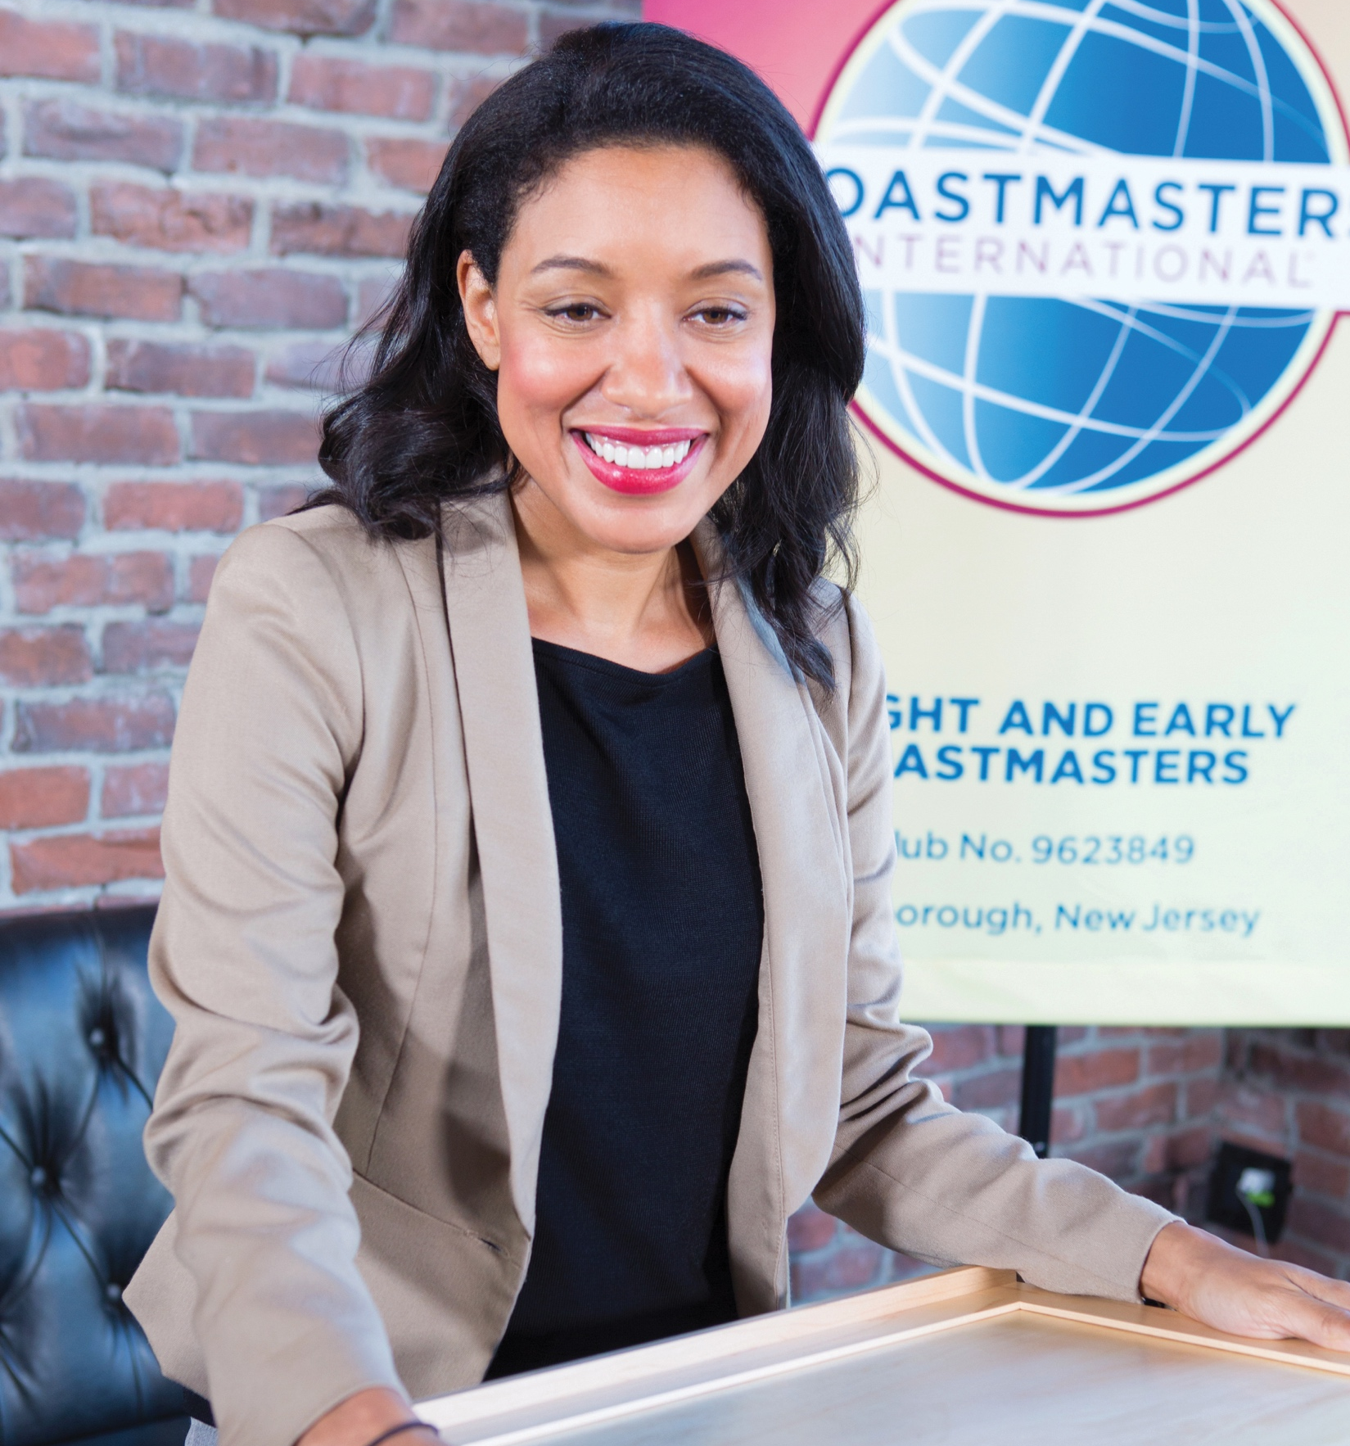
General Evaluator
We recommend waiting until you have observed a few meetings.
Resources:
  A Toastmaster Wears Many Hats
  Effective Evaluation
  General Evaluator Checklist
As General Evaluator, skills practiced are critical thinking, organization, time management, motivation, and team-building.
Return
Notes:
The General Evaluator evaluates the club meeting. In addition, the General Evaluator conducts the evaluation portion of the meeting and is responsible for the evaluation team, including the speech evaluators, Ah-Counter, grammarian, and timer. As General Evaluator, you:
Ensure other evaluators know their tasks and responsibilities.
Explain the purpose and benefits of evaluations to the group.
Identify and confirm meeting assignments with the timer, grammarian, and Ah-Counter.
Confirm the club meeting program and/or checklist with the Toastmaster.
Take notes and report on all club proceedings, including timeliness, enthusiasm, preparation, organization, performance of duties, etc.

Slide 15


The Toastmasters Pathways learning experience
There are 6 unique paths to help you achieve your goals.
Take the assessment to find the best one for you.
Each path features 5 levels.
Check out The Navigator for more information.
Return
Notes:
Pathways is Toastmasters’ education program. Currently, there are 6 unique paths to help you achieve your goals. An online assessment is available for you to take. At the end, it will recommend three paths that best fit your goals.
Each path has 5 levels. In Level 1, you will master the fundamentals. Level 2 is all about learning your style. In Level 3, you begin to increase your knowledge. You will take what you have learned and start to build skills in Level 4. Level 5 is all about demonstrating expertise and, finally, before completing your path, there is one final project. Reflect on Your Path allows you to consider your growth and share your experience with your club.
Every path has required and elective projects. To complete a path, you must complete all 11 required projects and four elective projects, though you can opt to complete as many electives as you would like.
For more in-depth knowledge on Pathways, check out The Navigator, which can be found by going to www.toastmasters.org/TheNavigator.

Slide 16
What’s your path?
Dynamic Leadership
Engaging Humor
Motivational Strategies
Persuasive Influence
Presentation Mastery
Visionary Communication
Return
Notes:
(Note for presenter: If your new member is interested and you are comfortable doing so, you can suggest a learning path based on their goals. Skip to that path’s slide to show more information about it.)
Here is a list of all 6 paths. If you're not ready to select a path today, you can view information about the paths and sample your first project on the Toastmasters website. Once you've selected a path, you'll be able to log into Base Camp, which is the home of Pathways. On Base Camp, you'll be able to access resources, earn badges, and interact with members of your club.

Slide 17


Dynamic Leadership
Main skills built:
  Public speaking
  Interpersonal
  communication
  Management
Additional skills built:
  Strategic leadership
  Conflict resolution
Dynamic Leadership
Level 1
Level 2
Level 3
Level 4
Level 5
Return
Notes:
This path helps you build your skills as a strategic leader. The projects in this path focus on understanding leadership and communication styles, the effect of conflict on a group, and the skills needed to defuse and direct conflict. These projects also emphasize the development of strategies to facilitate change in an organization or group, interpersonal communication, and public speaking. This path culminates in a project focused on applying your leadership skills.

Slide 18

Engaging Humor
Main skills built:
  Public speaking
Additional skills built:
  Speech writing
Engaging Humor
Level 1
Level 2
Level 3
Level 4
Level 5
Return
Notes:
This path is designed to help you build your skills as a humorous and engaging public speaker. The projects on this path focus on understanding your sense of humor and how that sense of humor translates to engaging audience members. The projects contribute to developing an understanding of how to effectively use humor in a speech, including challenging situations and impromptu speeches. This path culminates in an extended humorous speech that will allow you to apply what you learned.

Slide 19

Motivational Strategies
Main skills built:
  Public speaking
  Interpersonal communication
  Management
Additional skills built:
  Motivational
  leadership
  Motivational communication
Motivational Strategies
Level 1
Level 2
Level 3
Level 4
Level 5
Return
Notes:
This path helps you build your skills as a powerful and effective communicator. The projects focus on learning strategies for building connections with the people around you, understanding motivation, and successfully leading small groups to accomplish tasks. This path culminates in a comprehensive team-building project that brings all of your skills together—including public speaking.

Slide 20

Persuasive Influence
Main skills built:
  Public speaking
  Management
  Interpersonal communication
Additional skills built:
  Leading in
  complex situations
Persuasive Influence
Level 1
Level 2
Level 3
Level 4
Level 5
Return
Notes:
This path helps you build your skills as an innovative communicator and leader. The projects on this path focus on how to negotiate a positive outcome together with building strong interpersonal communication and public speaking skills. Each project emphasizes developing leadership skills to use in complex situations, as well as creating innovative solutions to challenges. This path culminates in a “High Performance Leadership” project of your design.

Slide 21

Presentation Mastery
Main skill built:
  Public speaking
Presentation Mastery
Level 1
Level 2
Level 3
Level 4
Level 5
Return
Notes:
This path helps you build your skills as an accomplished public speaker. The projects on this path focus on learning how an audience responds to you and improving your connection with audience members. The projects contribute to developing an understanding of effective public speaking technique, including speech writing and speech delivery. This path culminates in an extended speech that will allow you to apply what you learned.

Slide 22

Visionary Communication
Main skills built:
  Public speaking
  Management
  Interpersonal communication
Additional skills built:
  Innovative communication
  Leadership
Visionary Communication
Level 1
Level 2
Level 3
Level 4
Level 5
Return
Notes:
This path helps you build your skills as a strategic communicator and leader. The projects on this path focus on developing your skills for sharing information with a group, planning communications, and creating innovative solutions. Speech writing and speech delivery are emphasized in each project. This path culminates in the development and launch of a long-term personal or professional vision.

Slide 23

Mentoring
Experienced mentors encourage, guide, and support you in your goals and help you to achieve more than you thought possible.
Return
Notes:
(Note to presenter: If you are this person’s mentor, outline how you are available to help them and the best way to contact you. If you are a club officer, outline what a mentor does and then work to assign a mentor to them.)
Each new member is assigned a mentor to help them through their Toastmasters journey. Whenever you have a question, need help, or feel lost, your mentor is a great person to turn to.

Slide 24
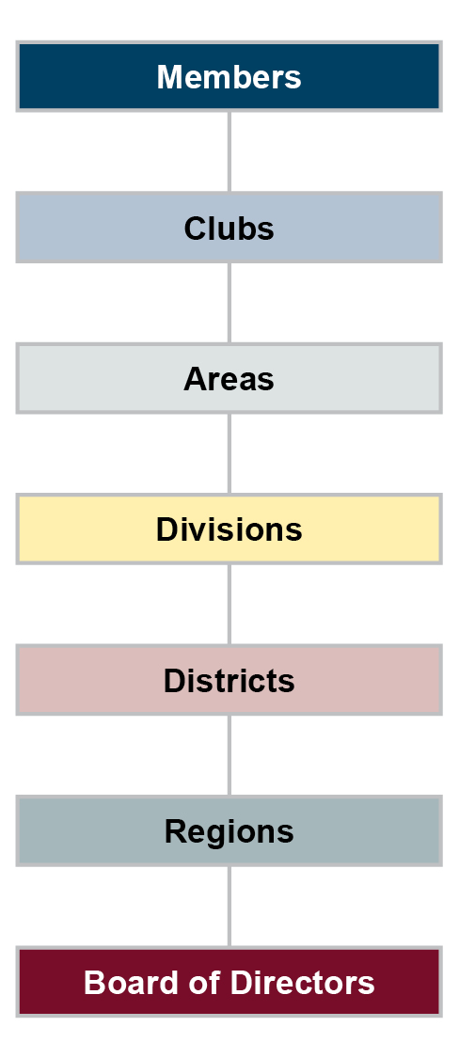
Leadership opportunities
To develop your leadership skills, you can serve as a club officer. Then consider moving on to additional leadership opportunities throughout the organization to continue your development.
Return
Notes:
To grow your leadership skills, consider taking up one of the numerous leadership opportunities afforded to you in Toastmasters. Start as a club officer, where you can help our club run smoothly and support members as they strive for self-improvement. Toastmasters clubs are grouped into Areas, then Divisions, Districts, and finally regions. There are leadership opportunities at all levels, with each step up seeing an exponential increase in the number of people you are serving. The Toastmasters Board of Directors are also made up of volunteers serving two-year terms!
if you are wondering why the Board is at the bottom and the members are at the top of the graph, it is because everything in Toastmasters revolves around our clubs and our members.

Slide 25
Developing leadership skills
Area
—
Division
District
—
Region
Club
Gain experience in each Officer Role
  President
  VP Education
  VP Membership
  VP Public Relations
  Secretary
  Treasurer
  Sergeant at Arms
Gain further experience in mid-level roles:
Area Director
Division Director
Share your skills by running for these top-level roles:
District Director
Program Quality Director
Club Growth Director
Finance Manager
Administration Manager
Region Advisor
International Director
Return
Notes:
Here is an outline of all of the volunteer leadership roles available at each level. Each level offers valuable experience that will help you in your career or your life outside Toastmasters. Start by leading a small team of individuals at the club level. At the Area and Division level, you can learn what it is like to be a mid-level manager or oversee larger teams. District leaders, Region Advisors, and Board of Director members gain experience as senior leaders and executives.

Slide 26
Getting started
Welcome email
  Add as a safe sender
  If you do not receive the email, check your spam filters
Click “Set up account”
Follow the steps
Return
Notes:
Now that you are a member of our club and we have discussed some basics of Toastmasters, it is time to talk about what is next for you. To start, open the Welcome email from Toastmasters International. The email is titled "Welcome to your new journey!" Click the “Set up account” button and follow the outlined steps.
It is a good practice to mark Toastmasters as a safe sender, as it will help ensure you get all necessary emails about your membership. If you did not receive the email, check your spam folders.
After you have followed the steps and chosen your path, the journey is the same for everyone. Level 1 in all paths starts with an Ice Breaker project, which is an opportunity to introduce yourself to your new club members.

Slide 27
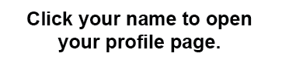
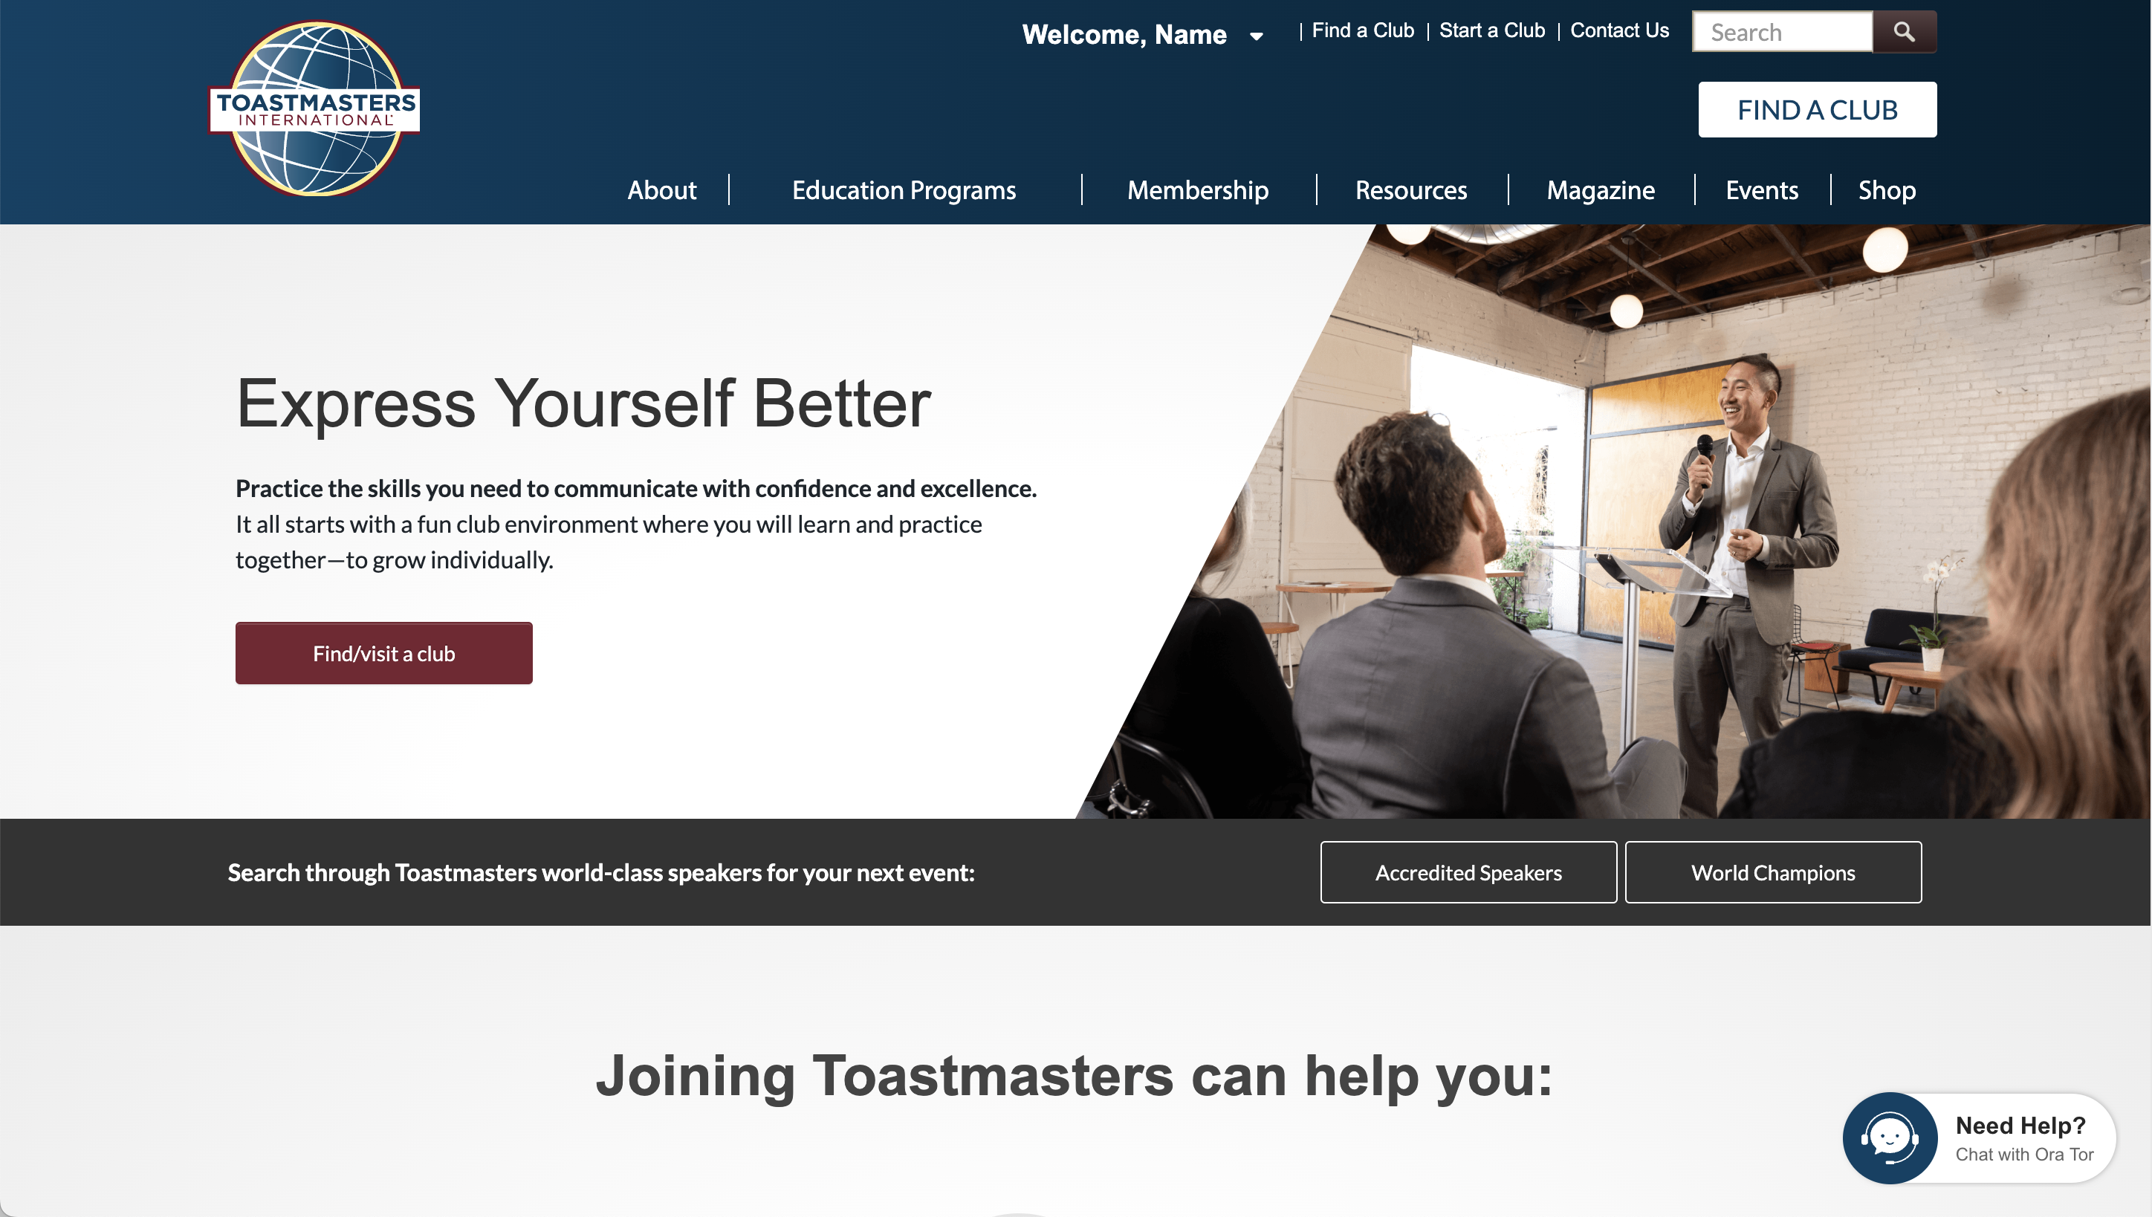
Verifying your profile
Notes:
After following the steps in the Welcome email, it is important that you sign in, click on your name at the top of the page, visit your profile, and ensure all of your personal information is correct. This is the information that will be used to contact you or to mail you awards and certificates.

Slide 28
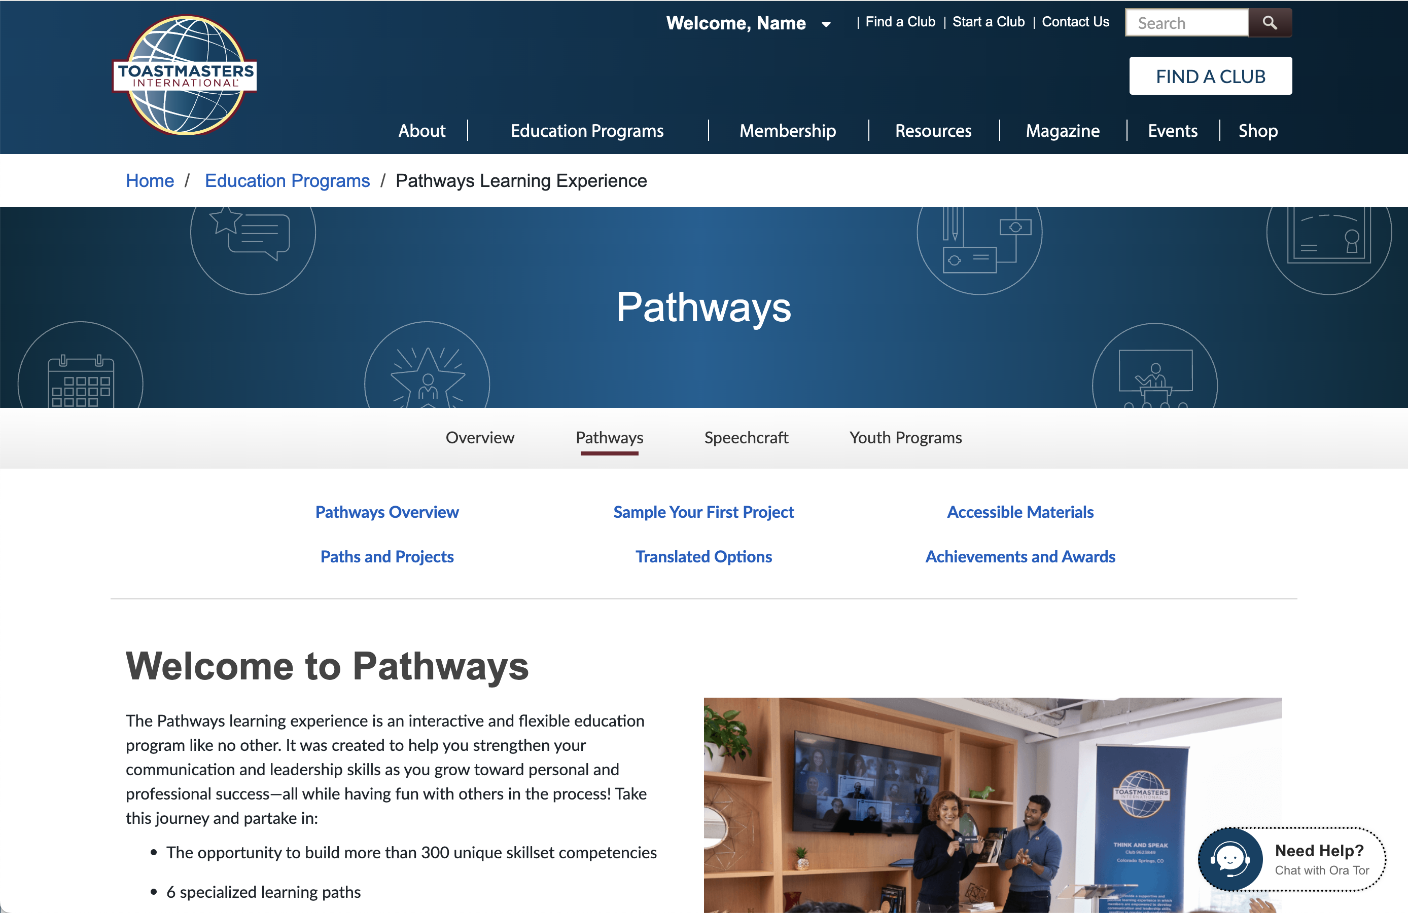

Logging in to Pathways
Notes:
Base Camp is the home of Pathways. It is where all your projects will be found. To get there, simply login to the Toastmasters website and select the Go To Base Camp card from My Home.

Slide 29
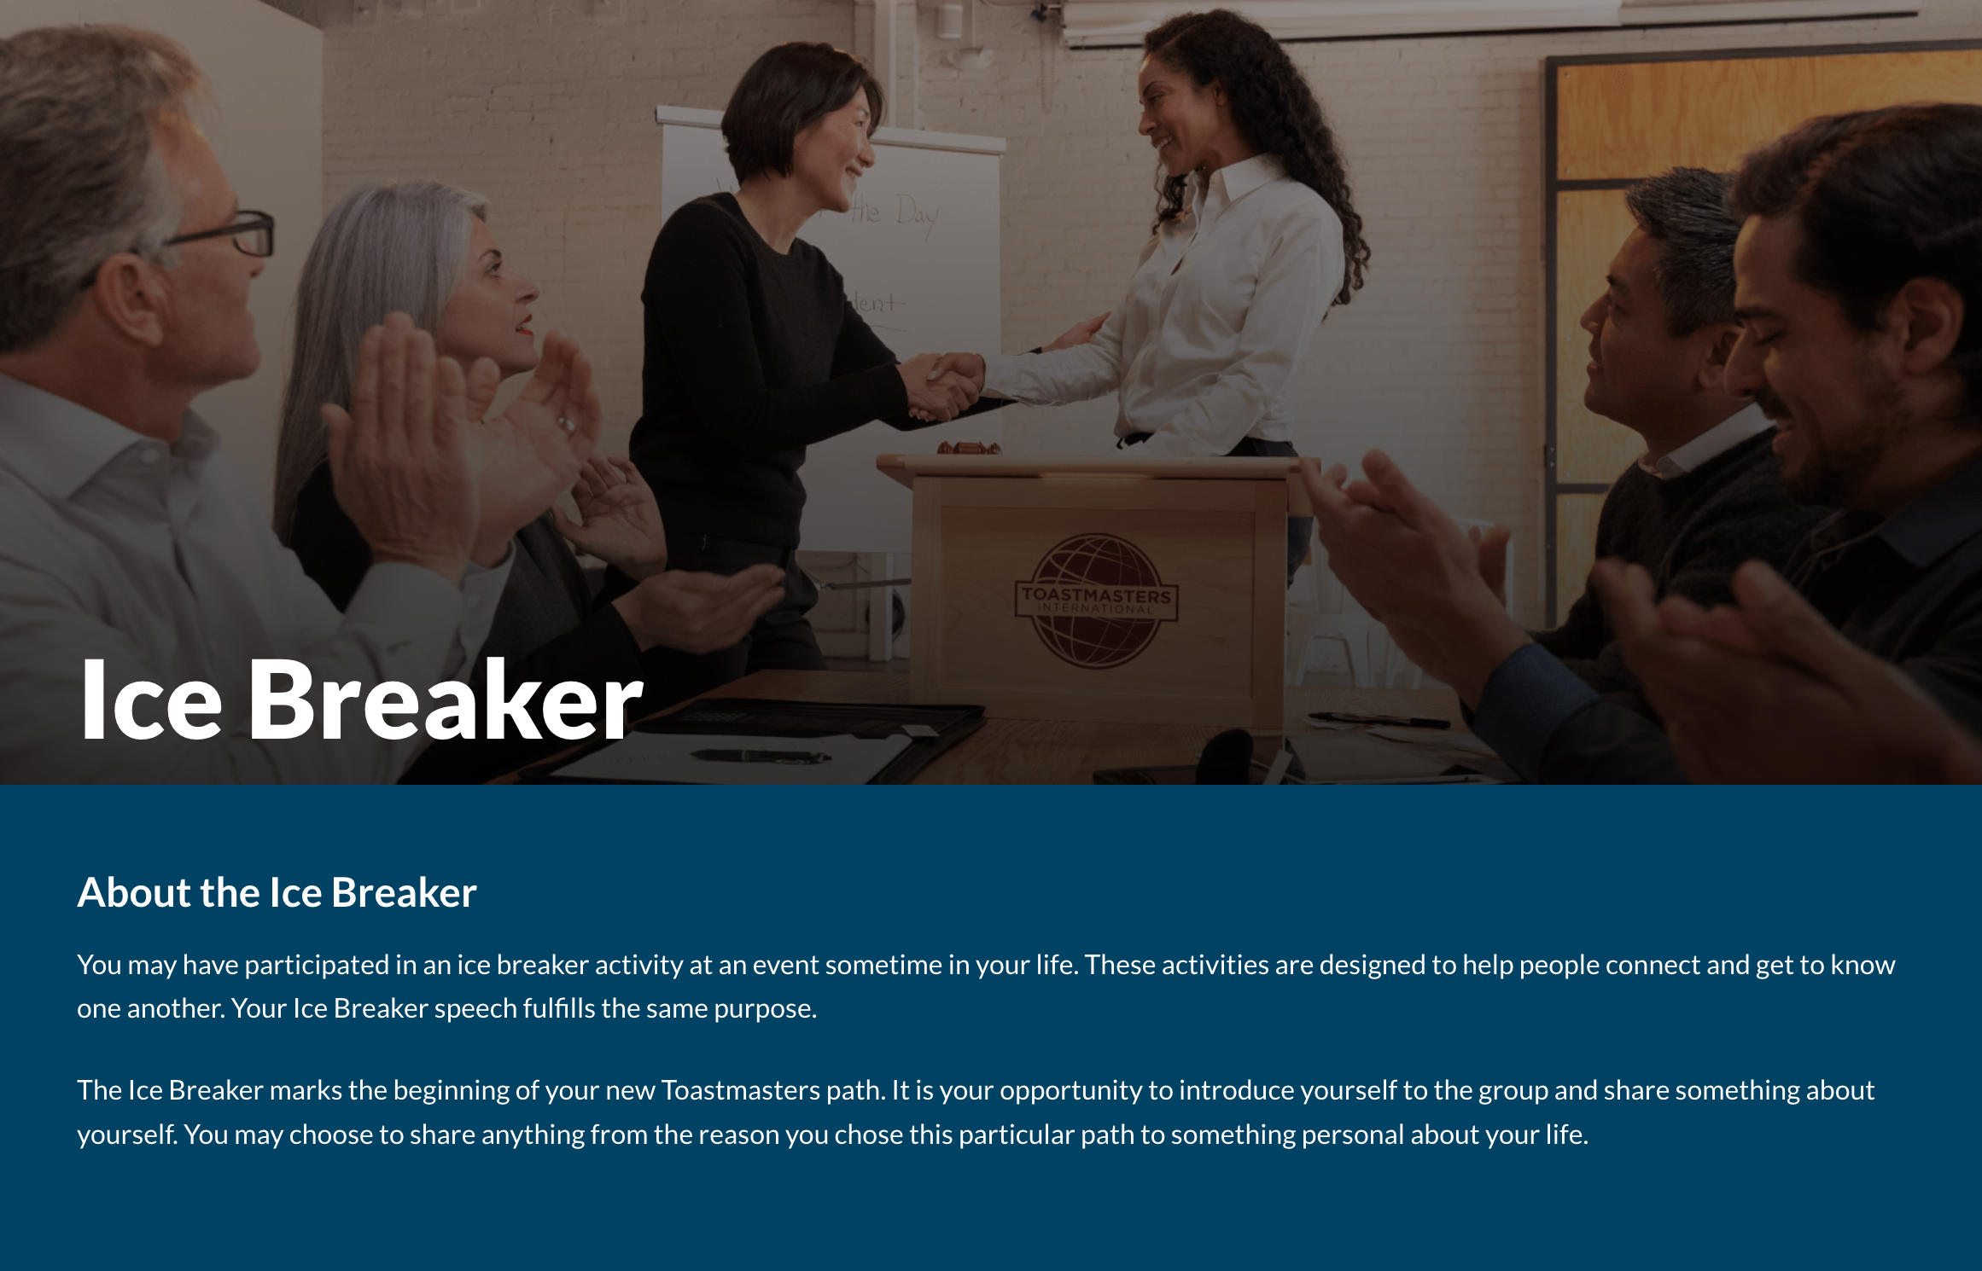
Your first project: The Ice Breaker
Everyone begins with this Level 1 project.
Notes:
All paths begin with an Ice Breaker. This introductory speech is a great way to give fellow club members information about your background, interests, and ambitions. (Note to presenter: As you speak about the Ice Breaker, outline your club’s expectations, if any. Remember, a lot of new members have a fear of public speaking, so do not scare them or pressure them into their first project.)

Slide 30
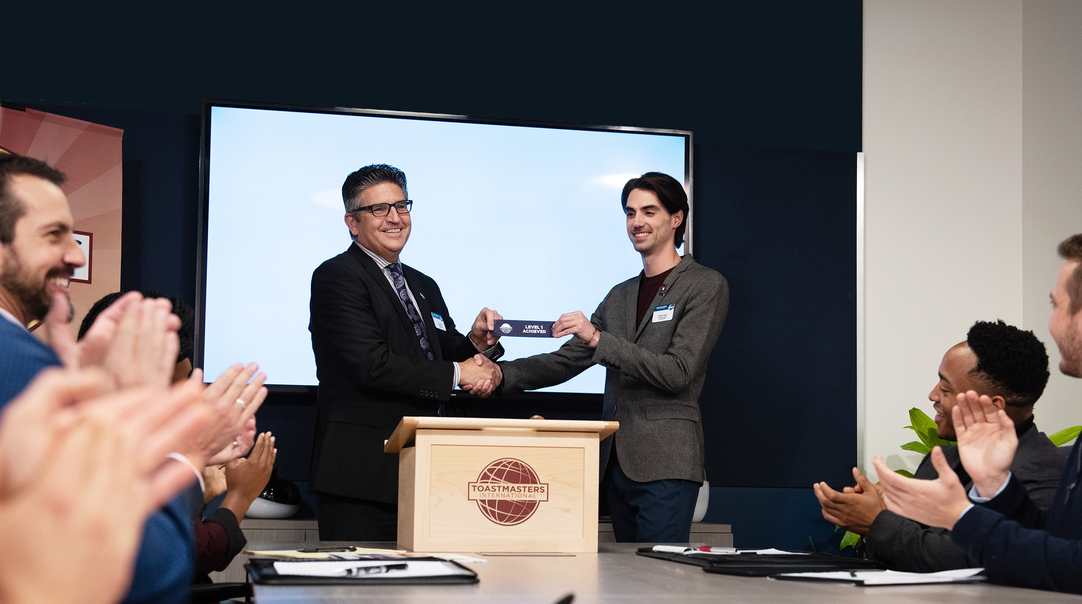
Awards and recognition
Notes:
In Toastmasters, there are several ways that we recognize our members and acknowledge all their hard work. Let us look at a few of them.

Slide 31



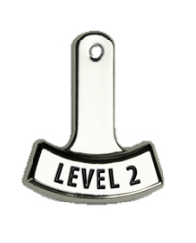




Recognition of achievements
Earn ribbons during meetings
Pins are available for each learning path
Add a level tag to show off progress
Receive a Proficient pin upon Path completion
Notes:
(Note for presenter: Update this slide to match what your club does. We encourage all clubs to use as many forms of recognition as possible.)
During each meeting, you have a chance to earn a ribbon recognizing your accomplishments. There are awards for Best Table Topics®, Best Speaker, and Best Evaluator. When you complete your Ice Breaker, you will receive an Ice Breaker ribbon.
There are also path pins, which you can wear to show fellow members what learning path you are on. Each time you complete a level, add a level tag to signify your process. When you complete a path, you can receive a Proficient pin to show off your hard work!

Slide 32
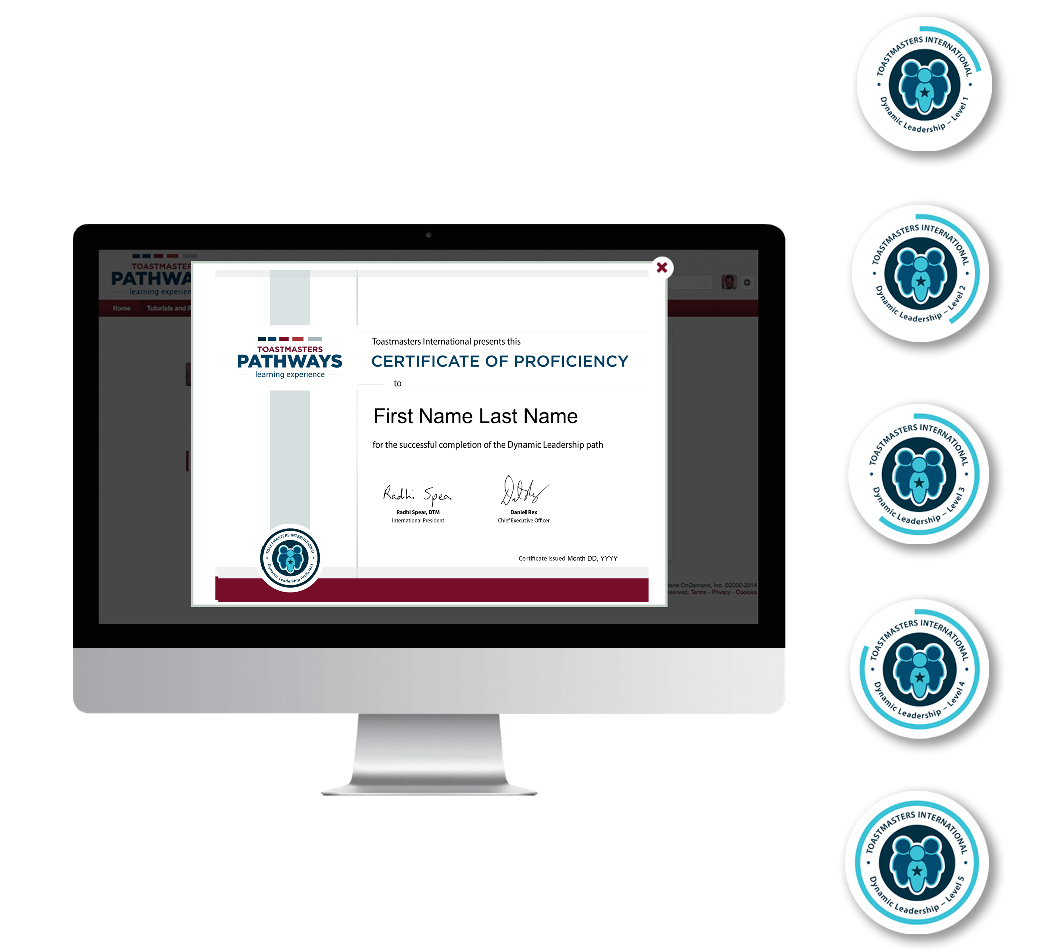
Education badges and awards
Receive digital badges on Base Camp
Earn badges for each
level completed
Earn a path badge when you finish a path
Award feedback badges
to others
Receive certificates for
level and path completions
Notes:
You can earn digital badges for your work on Base Camp. Each time you complete a level in a learning path, you earn a badge! You will also earn one for completing a path. Not only can you receive badges, but you can give them as well! Notice that someone has done exceptionally well recently in your club? Recognize them with a digital badge, including a Collaborative Badge, an Inspirational Badge, and an Exceptional Badge, and more. All the badges you earn will be displayed on Base Camp for you and your fellow club members to see.
Upon completion of a path, you will also receive a Certificate of Proficiency, which you can print yourself or you can request a printed copy from World Headquarters.

Slide 33
Club expectations and policy
Please review our club policies and the Addendum of Standard Club Options
You must attend [#] meetings per month.
If you miss [#] meetings, then [consequence].
Our dress code is [].
Taboo topics are [].
Our club culture is [].
Return
Notes:
(Note for presenter: Before the presentation, update these slides. Update any and all information in brackets. Feel free to delete any bullets that do not apply to your club. Use this slide as an opportunity to discuss any policies and expectations your club may have with its new member. If you have your policy written down, share it with the new member, along with the Addendum of Standard Club Operations.)

Slide 34
How we communicate with you
Club meeting
Email
[Any additional communication methods]
[Any additional communication methods]
Club Resources
  Website
  Newsletter
  Policy
Notes:
Let us talk about the methods our club will use to communicate with you. First and foremost, club meetings are always a great place to speak to fellow members and club officers. If you have questions or comments, attending a club meeting is a great way to share what is on your mind. Furthermore, it is a great place for us to share news with the club.
We will also pass along any important updates via email. It is important that the email you provide us is one that you check regularly, as it will be the method we use to announce any meeting cancellations.
(Note for presenters: If you have any additional methods of communication, add them to the slide and share them with the new member.)
We also have various club resources available. Our club has a website, which is [URL.] We send out a newsletter every [week, month, quarter]. For your benefit, we also have written policy available for you to review.
(Note for presenter: Customize the club resources your club uses and outline how you use them. If you use your club’s website to allow members to sign up for meeting roles and to schedule their speeches, outline this here. If you have a newsletter, tell them how often it is distributed, how it is distributed, and what content is in it. If your club has written policy, tell the new member where they can find it.)

Slide 35

Questions/Concerns/Answers
Notes:
What questions do you have? How can I help make your Toastmasters journey as smooth as possible?

Slide 36
Thank you for attending!
New Member Orientation

