Slide 1
Club Visits
Re-name Yourself in Zoom
(include your role)
Example: AD Carlos Mendoza
For Technology Support
Chat with Zoom Master
1

Slide 2
Club Visits
Session #
Please “re-name” yourself to include your role
(Example: VPE Carlos Mendoza)
Receive session workbook in chat
2

Slide 3
Agenda
Club Visits
What is a Successful Club Visit?
Club Visit Outcomes
3

Slide 4



Identify
Recognize
Develop
Identify what a successful club visit looks like
Recognize club visit outcomes
Develop strategies to hold productive and successful club visits
4

Slide 5

What is a Successful Club Visit
5

Slide 6
Breakout Room Activity:
Visits that Count
6

Slide 7
Breakout Room Tips
Click “Join Breakout Room” button
Use Zoom tools as needed (Share Screen, Annotate, Whiteboard)
Assign a Timekeeper
Watch for Broadcast and Chat messages
Use “Ask For Help” button
Join Breakout Room
7

Slide 8
Visits that Count Activity Instructions
  Join your team in a breakout room (automatic)
  Use the guiding questions to discuss and define what a successful club visit is.
  Select a spokesperson to present your group’s description of what a successful club visit fur up to 1-2 minutes.
  You have 15 minutes
  Start on page 2 in your Session Workbook
8

Slide 9
Present your results, key ideas, and recommendations for each phase
(1-2 minutes per team)
9

Slide 10
Review: Successful Club Visits
Preparation is the key to successful club visits
10

Slide 11
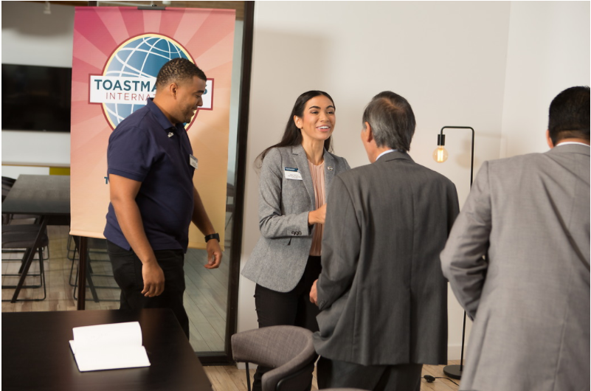
Club Visit Outcomes
11

Slide 12
What can you accomplish during a club visit?
12

Slide 13
Breakout Room Activity:
Success and Support
13

Slide 14
Breakout Room Tips
Click “Join Breakout Room” button
Use Zoom tools as needed (Share Screen, Annotate, Whiteboard)
Assign a Timekeeper
Watch for Broadcast and Chat messages
Use “Ask For Help” button
Join Breakout Room
14

Slide 15
Success and Support Activity Instructions
  Join your team in a breakout room (automatic)
  Using the table in the Participant Workbook, discuss common challenges clubs face and match resources that will help a club experiencing that challenge.
  You have 25 minutes
  Start on page 3 in your Session Workbook
15

Slide 16
What are some of the key areas of success that you can see using the Dashboard before you visit a club?
16

Slide 17
What successes can you easily identify during a visit?
17

Slide 18
What are some common issues that a club may need support in?
What resources can you give to support them?
18

Slide 19
What other ways can you add value to a club during your visit?
19

Slide 20
Review: Success and Support
Be ready to recognize successes and support clubs to succeed
20

Slide 21
Conclusion
Club Visits
What is a Successful Club Visit?
Club Visit Outcomes
21

Slide 22
What is one thing you learned from this session that you will implement in your club visits?
22

Slide 23
Session Assessment
Go to link in Chat
You have 5 minutes
23

Slide 24
[Insert text]
24

