Slide 1
Area Director Expectations
Re-name Yourself in Zoom
(include your role)
Example: AD Priya Patel
For Technology Support
Chat with Zoom Master

Slide 2
Area Director Expectations
Session #
Please “re-name” yourself to include your role
(Example: VPE Priya Patel)
Receive Session Workbook in chat

Slide 3
Agenda
Area Director Expectations
Making an Impact in Your Area
The Roles Around You

Slide 4

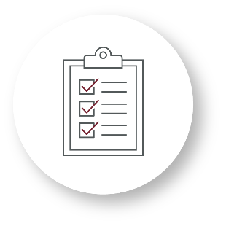

Recognize
Recognize
Identify
Recognize the relationships with stakeholders and leaders in the District
Recognize the importance of supporting clubs by fulfilling their role
Identify the expectations of the role

Slide 5

Making an Impact in Your Area

Slide 6
Breakout Room Activity:
The Difference You Make

Slide 7
Breakout Room Tips
Click “Join Breakout Room” button
Use Zoom tools as needed (Share Screen, Annotate, Whiteboard)
Assign a Timekeeper
Watch for Broadcast and Chat messages
Use “Ask For Help” button
Join Breakout Room

Slide 8
The Difference You Make Activity Instructions
  Join your team in a breakout room (automatic)
  Using the table in the Session Workbook paint a picture of the impact that your role can have on members, leaders, and your District.
  You have 25 minutes
  Start on page 2 in your Session Workbook

Slide 9
What meaningful impact can an Area Director make on communication between clubs in their Area?
How can this impact be delivered?

Slide 10
What meaningful impact can an Area Director make on Club Presidents in their Area?
How can this impact be delivered?

Slide 11
What meaningful impact can an Area Director make on the achievement of member goals in their Area?
How can this impact be delivered?

Slide 12
What meaningful impact can an Area Director make on alignment between their District, Division, and clubs in their Area?
How can this impact be delivered?

Slide 13
Review: Making an Impact in Your Area
Look to make a positive impact wherever you can.
Focus on areas that you can have the most significant impact.

Slide 14

The Roles Around You

Slide 15
Breakout Room Activity:
All the Roles Around You

Slide 16
Breakout Room Tips
Click “Join Breakout Room” button
Use Zoom tools as needed (Share Screen, Annotate, Whiteboard)
Assign a Timekeeper
Watch for Broadcast and Chat messages
Use “Ask For Help” button
Join Breakout Room

Slide 17
All the Roles Around You Activity Instructions
  Join your team in a breakout room (automatic)
  Complete the exercise in your Session Workbook by defining and connecting roles with responsibilities.
  You have 20 minutes
  Start on page 5 in your Session Workbook

Slide 18
Which roles rely most on your support?

Slide 19
Which roles in the District do you most depend on to fulfill your responsibilities?

Slide 20
Review: All the Roles Around You
Know who depends on you and who you depend on as Area Director
Know what you need to deliver and to whom in order to achieve success

Slide 21
Conclusion
Area Director Expectations
Making an Impact in Your Area
The Roles Around You

Slide 22
What is one thing you learned from this session that you will implement in your role?

Slide 23
Session Assessment
Go to link in Chat
You have 5 minutes

Slide 24
[Insert text]

