Slide 1
Division and Area Director Training
SESSION 5
Thrive in the District Recognition Program

Slide 2
Instruction Slide Only
Please Note:
The following slides are designed to be used in brightly lit rooms.

Slide 3

Session Agenda
Distinguished Club Program
District Recognition Program

Slide 4
Session Objectives
Describe how Moments of Truth leads to club quality
Define roles of Division and Area Directors
Describe the Distinguished Club Program
Identify goals of Distinguished Division and Area programs
Describe importance of club, Area, and Division Success Plans
Identify District Recognition Program and Distinguished Club Program resources

Slide 5
Moments of Truth
First Impressions
Membership Orientation
Fellowship, Variety, and Communication
Program Planning and Meeting Organization
Membership Strength
Achievement Recognition

Slide 6
Qualifying Requirements
Distinguished Club Program
Membership of 20 or a net growth of at least five new members as of June 30
Club Success Plan submission no later than September 30

Slide 7
Membership Net Growth Definition
Membership net growth occurs when the total number of club members at year-end (June 30) exceeds the base amount.

Slide 8
Membership Base Definition
The membership base amount refers to the number, on July 1, of club members (renewing, new, charter, dual, and reinstated) who paid April dues.
The membership base may increase during the program year if members make late dues payments.

Slide 9
DCP Education Goals
Four members complete Level 1
Two members complete Level 2
Two more members complete Level 2
Two members complete Level 3
One member completes Level 4, completes a path, or obtains a DTM
One more member completes Level 4, completes a path, or obtains a DTM

Slide 10
Remaining DCP Goals
Four new members
Four more new members
Minimum of four club officers trained during each of two training periods
One membership dues-renewal report and one club officer list submitted on time

Slide 11
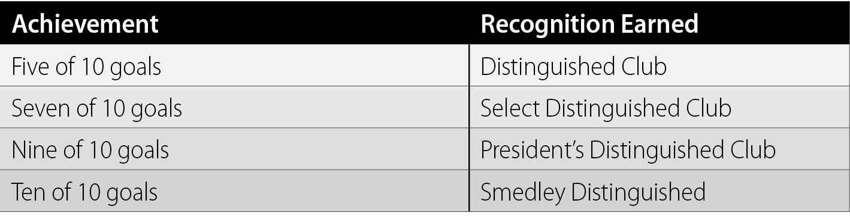
Distinguished Club Program
Distinguished, Select Distinguished, President’s Distinguished, Smedley Distinguished

Slide 12
Club Timeline - Vocal Violinists of Vienna
MONTH | TASK
July | Club officers Gunther, Gisela, Gustav, and Gretchen are trained
August | Carolina earns her Level 1 Pathways award, Gisela earns her Level 2 Pathways award
September | New member Novak joins the club, the member dues-renewal report is submitted
October | Casper earns his Level 1 Pathways award
November | New members Nick and Nixie join the club
December | New member Nan joins the club
January | Karl earns his Level 4 Pathways award, new member Nadia joins the club
February | Club officers Gunther, Gisela, Gustav, and Gretchen are trained
March | New member Norbert joins the club, Gretchen earns her Level 2 Pathways award
April | Adolf earns his Level 5 Pathways award, new member Neil joins the club
May | New member Naveen joins the club, the Club Officer report is submitted
June | On June 30, the Vocal Violinists of Vienna Club has 25 members

Slide 13
Club Timeline – Linguistic Leaders of Lipari
MONTH | TASK
July | Club officers Lina, Luigi, Luciano, and Leonora are trained
August
September | Cara earns her Level 1 Pathways award
October | Carlo and Lena earn their Level 1 Pathways award
November | New members Natalia and Nevio join the club
December | New member Nico joins the club
January
February | Club officers Lina, Luigi, Luciano, and Leonora are trained
March | New member Nuncio joins the club, Amara earns her Level 2 Pathways award
April | Adolfo earns his Level 2 Pathways award
May | Columbo earns his Level 1 Pathways award, the Club Officer report is submitted
June | On June 30, the Linguistic Leaders of Lipari Club has 21 members

Slide 14
Club Timeline – Rhetorical Rants of Rabat
MONTH | TASK
July | Club officers Rashida, Reza, Raed, and Rafi are trained
August | Karida earns her Level 1 Pathways award
September | New member Nahla joins the club, the member dues-renewal report is submitted
October | Khalid earns his Level 1 Pathways award
November | New members Nasli and Noma join the club, Azana earns her Level 2 Pathways award
December | New member Naja joins the club, Adli earns his Level 2 Pathways award
January | Karim earns his Level 4 Pathways award, new member Nuria joins the club
February | Khalil and Kadeem earn their Level 1 Pathways awards
March | New member Nabil joins the club, Reza and Rashida earn their Level 2 Pathways awards
April | Adnan and Rafi earn their Level 5 Pathways award, new member Nayef joins the club
May | New member Noura joins the club, the Club Officer report is submitted
June | On June 30, the Rhetorical Rants of Rabat Club has 25 members

Slide 15
Qualifying Requirements
Distinguished Area Program
No net club loss
Submit the Area Director’s Club Visit Report for 75% of club base
First round visits by November 30th
Second round visits by May 31st

Slide 16
Net Club Loss Definition
Net club loss occurs when the total number of clubs at year-end (June 30) falls below the base amount.

Slide 17
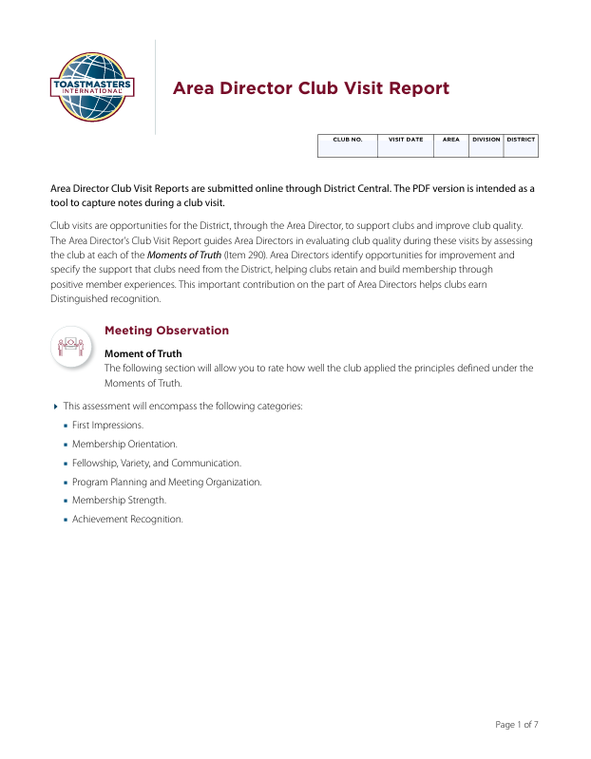
Area Director’s Club Visit Report

Slide 18
Area Club’s Base Definition
The Area’s club base is the number of paid clubs assigned to the Area as of July 1.
Clubs are considered to be paid when they have submitted a complete April dues-renewal report.
These and new clubs chartered between April 1 and June 30 are counted in the club base.
The club base may increase after July 1 if April club dues are paid late.

Slide 19
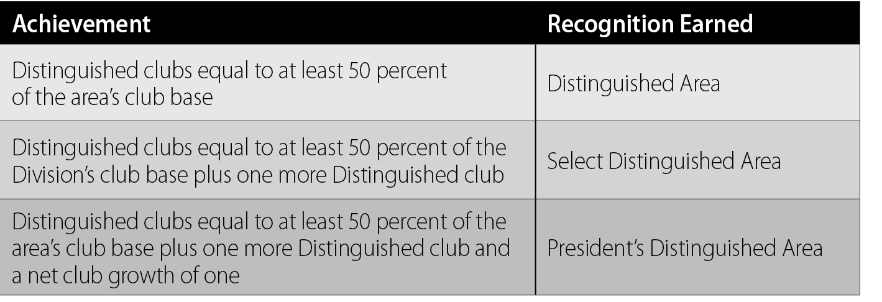
Distinguished Area Program
Distinguished, Select Distinguished, President’s Distinguished

Slide 20
Qualifying Requirement
Distinguished Division Program
No net club loss

Slide 21
Net Club Loss Defintion
Net club loss occurs when the total number of clubs at year-end (June 30) falls below the base amount.

Slide 22
Division’s Club Base Definition
The Division’s club base is the number of paid clubs assigned to the Division as of July 1.
Clubs are considered to be paid when they have submitted a complete April dues-renewal report.
These and new clubs chartered between April 1 and June 30 are counted in the club base.
The club base may increase after July 1 if April club dues are paid late.

Slide 23
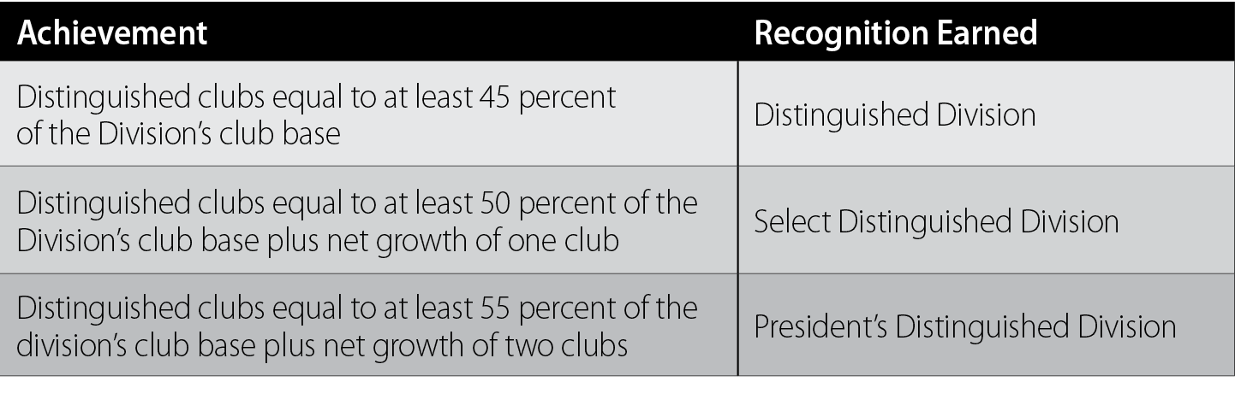
Distinguished Division Program
Distinguished, Select Distinguished, President’s Distinguished

Slide 24
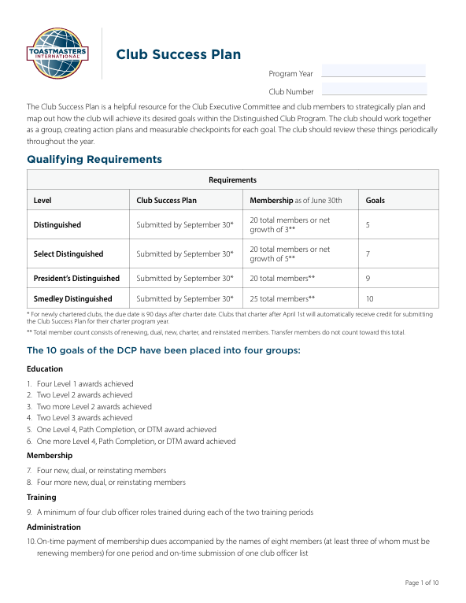
Club Success Plan

Slide 25
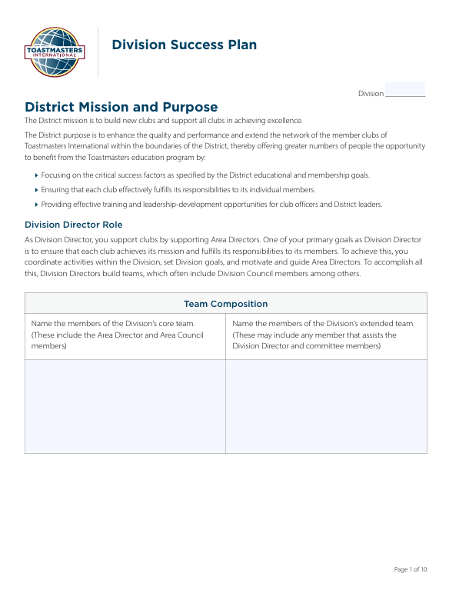
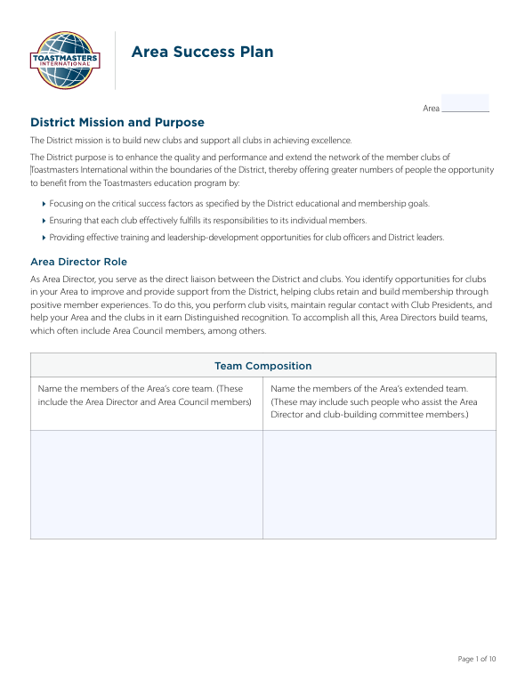
Division and Area Success Plans

Slide 26
Stretch and Additional Goals
Many Districts encourage Division and Area Directors to stretch the goals outlined in the Distinguished Division and Area programs or accomplish additional goals.

Slide 27
Review
Describe how Moments of Truth leads to club quality
Define roles of Division and Area Directors
Describe the Distinguished Club Program
Identify goals of Distinguished Division and Area programs
Describe importance of club, Area, and Division Success Plans
Identify District Recognition Program and Distinguished Club Program resources

Slide 28
Conclusion: Closing Remarks
The DCP is the foundation of the District Recognition Program.
The Distinguished Area, Division, and District programs align with the DCP.
Division and Area Directors should be aware of club goals.
Completing success plans helps clubs, Areas, and Divisions stay on track.
There are resources available for tracking Distinguished goal progress.

