Slide 1
Division and Area Director Training
SESSION 3
Establish and Support New Clubs

Slide 2
Instruction Slide Only
Please Note:
The following slides are designed to be used in brightly lit rooms.

Slide 3

Session Agenda
Mission and goals
Club builders
Club-building cycle

Slide 4
Session Objectives
  Describe relationship between establishing new clubs and the Toastmasters and District missions.
  Identify which District leader responsibilities help establish new clubs.
  Recognize the support available to establish new clubs.
  Describe the club-building cycle.
  Identify opportunities for new clubs.

Slide 5
Toastmasters Mission
We empower individuals to become more effective communicators and leaders.

Slide 6
District Mission
We build new clubs and support all clubs in achieving excellence.

Slide 7
New Clubs
New clubs offer Toastmasters benefits to more people.
Establishing new clubs provides improved communication and leadership experiences.
Division and Area Directors have support to build clubs.

Slide 8
Club Builders
All Toastmasters expand the network of clubs, Areas, and Divisions.
Division and Area Directors serve as liaisons between Districts and clubs.
Division and Area Directors work with sponsors and mentors.
Division and Area Directors fulfill duties that support club-building.

Slide 9
Club Builders Responsibilities Game
Club-building Responsibilities
Serve as contact for demonstration meetings and pre-charter information meetings
Generate interest and recruit members in new clubs
Show new clubs how to hold meetings and elect officers
Submit charter paperwork, fees, and dues to World Headquarters
Plan charter presentation meetings
A
DISTRICT
DIRECTOR
B
CLUB GROWTH DIRECTOR
C
CLUB
SPONSOR
D
CLUB
MENTOR

Slide 10
Club Builders Responsibilities Game
Club-building Responsibilities
Recruit, train, and supervise club-building team members, club sponsors, and club mentors
Receive leads from District Director and World Headquarters
Assist with prospect visits
Help plan demonstration meetings
Attend demonstration meetings and pre-charter information meetings
A
DISTRICT
DIRECTOR
B
CLUB GROWTH DIRECTOR
C
CLUB
SPONSOR
D
CLUB
MENTOR

Slide 11
Club Builders Responsibilities Game
Club-building Responsibilities
Share leads with Club Growth Director
Confirms alignment of new clubs
A
DISTRICT
DIRECTOR
B
CLUB GROWTH DIRECTOR
C
CLUB
SPONSOR
D
CLUB
MENTOR

Slide 12
Club Builders Responsibilities Game
Club-building Responsibilities
Guide clubs through first six to 12 months
Ensure club officers understand duties and how to perform them
Familiarize club officers with Toastmasters education program
Familiarize club officers with Distinguished Club Program
A
DISTRICT
DIRECTOR
B
CLUB GROWTH DIRECTOR
C
CLUB
SPONSOR
D
CLUB
MENTOR

Slide 13
District Director
Club-building Responsibilities
Share leads with Club Growth Director
Confirms the alignment of new clubs with the District

Slide 14
Club Growth Director
Club-building Responsibilities
Recruit, train, and supervise club-building team
Receive leads
  May forward leads to Division and Area Directors
As chair of the District marketing committee
  Assist club-building team
  Assist demonstration meeting team

Slide 15
Club Sponsors
Club-building Responsibilities
Follow-up with lead contacts
Serve as contact for demonstration meetings
Recruit members in new clubs
Show new clubs how to hold meetings and elect officers
Submit charter paperwork, fees, and dues
Plan charter presentation meetings

Slide 16
Club Mentors
Club-building Responsibilities
Guide clubs through first six to 12 months
Ensure club officers understand duties
Familiarize club officers with Toastmasters education program
Familiarize club officers with Distinguished Club Program
Help recruit and retain members

Slide 17
Club-building Team Support
Club-building efforts are supported by:
  Committees and teams
  Division and Area Directors
  Serve as members of a District committee
      Club extension committee
      Marketing committee
    Generate leads
    Find club sponsors and club mentors
    Facilitate and attend demonstration meetings and pre-charter information meetings

Slide 18
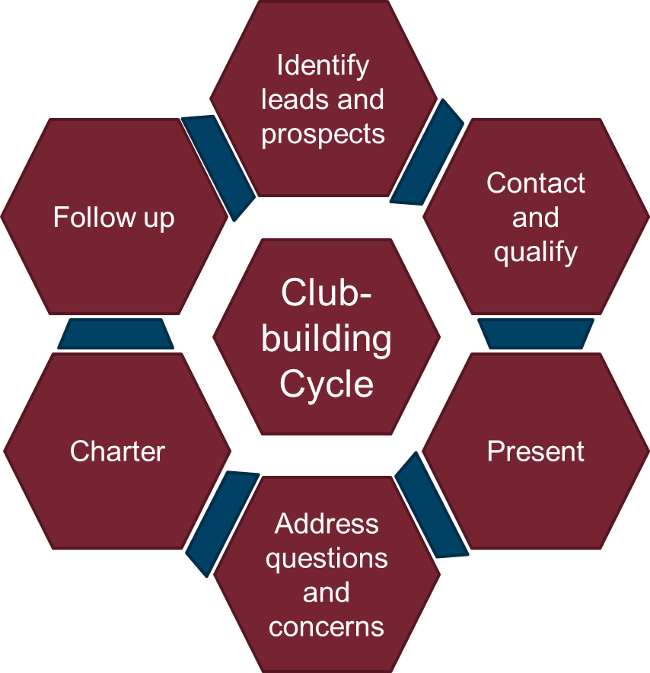
Club-building Cycle

Slide 19
Identify Leads and Prospects
Leads can come from
  World Headquarters
  Current members
  Neighbors
  Coworkers
  Many other places
Assess existing clubs to identify opportunities for new clubs
Target opportunities
  Communities over 10,000 people
  Corporations over 150 people

Slide 20
Contact and Qualify
Follow up with leads when requested
Understand business and needs of each lead
Contact lead promptly
To qualify the lead
  Identify the decision maker
  Explain how Toastmasters can help their corporation
  Ask questions, listen to their needs, offer solutions

Slide 21
Present
Conduct a demonstration meeting
Demonstration meeting resources
  Demonstration meeting team
  How to Build a Toastmasters Club guide
  Promotional material

Slide 22
Address Questions and Concerns
Address questions and concerns
Ask for opportunity to establish a new club

Slide 23
Charter
How to Build a Toastmasters Club guide
Club sponsor responsibilities
  Build membership to 20
  Submit Application to Organize a Toastmasters Club and charter fee
  Assist club in electing officers, adopting a club constitution, and submitting charter forms
  Schedule charter presentation meeting
Club mentors guide for six to 12 months

Slide 24
Follow Up
Club mentor responsibilities
  Ensure officers understand duties
  Maintain membership strength
  Explain Toastmasters education program and DCP
Cycle begins again

Slide 25
Review
  Describe relationship between establishing new clubs and the Toastmasters and District missions.
  Identify which District leader responsibilities help establish new clubs.
  Recognize the support available to establish new clubs.
  Describe the club-building cycle.
  Identify opportunities for new clubs.

Slide 26
Conclusion: Closing Remarks
Club-building is basic to missions of Toastmasters and the District.
District Directors, Club Growth Directors, club sponsors, and club mentors have club-building roles.
The District may establish club-building committees and teams.
The club-building cycle has six steps.
Division and Area Directors have opportunities to assist club building efforts.
Club leads can come from anywhere.

