Slide 1
Division and Area Director Training
SESSION 2
Enhance Club Quality

Slide 2
Instruction Slide Only
Please Note:
The following slides are designed to be used in brightly lit rooms.

Slide 3

Session Agenda
Quality clubs
Prepare to know the club
Club visits
Resources

Slide 4
Session Objectives
  Define club quality and a positive member experience
  Examine what contributes to club quality and a positive member experience
  Prepare for club visits
  Practice building trust during club visits
  Conduct effective club visits
  Propose solutions for club challenges

Slide 5
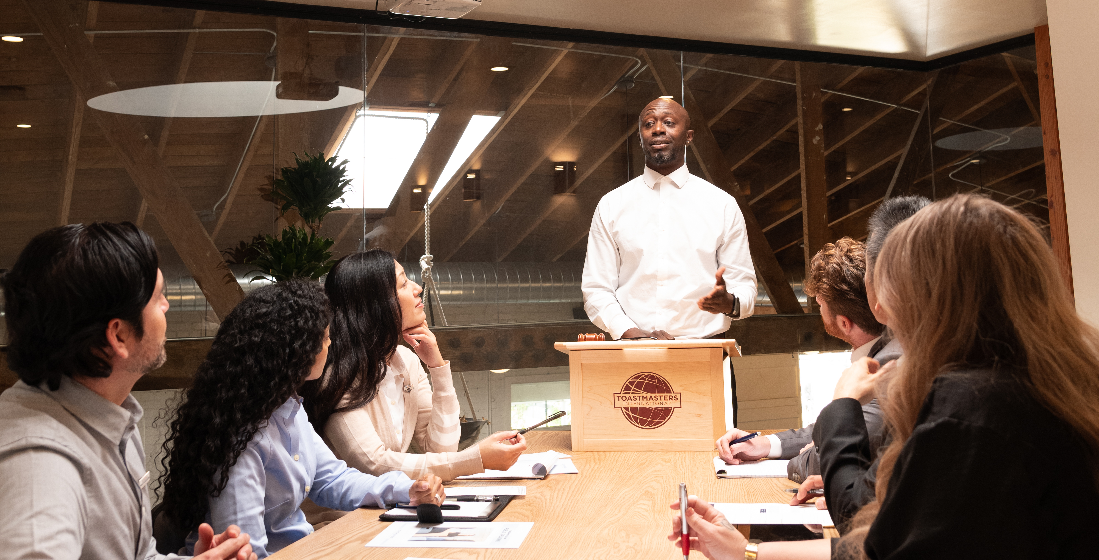
Club Quality

Slide 6
Member Experience
  Quality club environments lead to membership retention
  Great meetings make clubs successful
  Quality club meetings are well planned, well attended, organized, and fun
  Members improve their communication and leadership skills
  Quality clubs give members an opportunity to learn and grow

Slide 7
Membership, Education, and Leadership
Membership
  How do clubs attract and retain members?
The Toastmasters education program
  How can the club help its members meet their personal and professional education goals?
Club leadership
  How do club officers affect club quality and the member experience?

Slide 8
Gather Information
How can Area Directors gather information about a club before calling, emailing or visiting?

Slide 9
Club Visits
Foster club quality by visiting clubs
Answer questions and offer club support
Area Director’s Club Visit Report is a tool to help Area Directors during club visits

Slide 10
Trust
Build trust with clubs before and during club visits
  Building trust results in
    Clubs giving honest information
    Clubs being receptive to feedback
    Clubs see Area Directors as a resource

Slide 11
First Club Visit
Observations
  What to look for on your first club visit
    What first impression does the club make?
    How does the club orient new members?
    What’s the atmosphere of the meetings?
    How are meetings organized?
    How many members does the club have?
    How does the club recognize achievement?

Slide 12
First Club Visit
Distinguished Club Goals
  How to help clubs become distinguished
    Discuss club DCP progress
    Review Club Success Plan
    Remind club of deadlines
    Ask about club successes
    Ask about club goal challenges

Slide 13
First Club Visit
Discussion
  How to become the club’s trusted resource
    Ask questions about information gathered and observations
    Encourage club members to ask questions
    Ascertain unvoiced concerns
    Offer practical solutions to challenges
    Set up follow-up communications with club officers
    Use the Area Director’s Club Visit Report

Slide 14
After the First Visit
After the first visit
  Submit Area Director’s Club Visit Report
  Review report and discuss club with the Division Director
  Contact club president to:
    Share observations
    Congratulate club on their successes
    Identify how the District can support the club

Slide 15
Second Club Visit
Observations
  What to look for on the second club visit
    What are the similarities or differences from first visit?
    Which issues are unresolved from the first visit?
    Which suggestions have been implemented?
    How is the club progressing in the DCP?
    Acknowledge accomplishments

Slide 16
After the Second Visit
After the second visit
  Submit Area Director’s Club Visit Report
  Review report and discuss club with the Division Director
  Contact club president to:
    Share observations
    Congratulate club on their success
    Identify how the District can support the club

Slide 17

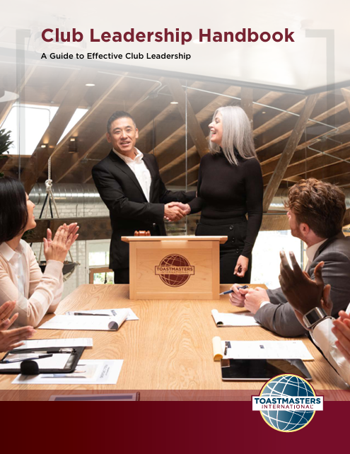


Resources

Slide 18
Review
  Define club quality and a positive member experience
  Examine what contributes to club quality and
  a positive member experience
  Prepare for club visits
  Practice building trust during club visits
  Conduct effective club visits
  Propose solutions for club challenges

Slide 19
Conclusion: Closing Remarks
Support clubs in creating a positive member experience.
The education program, club leadership, and membership contribute to club quality.
Prepare for club visits by building trust and gathering information.
During club visits continue building trust.
After club visits, Area Directors discuss how to help clubs with Division Directors.

