Slide 1
Division and Area Director Training
SESSION 1
Develop Successful Teams

Slide 2
Instruction Slide Only
Please Note:
The following slides are designed to be used in brightly lit rooms.

Slide 3

Session Agenda
Your team members
Your team agreement
Team motivation
Conflict resolution in a team

Slide 4
Objectives
Recount roles of Division and Area Directors
Identify members of Division and Area Councils and ways councils offer support
Describe a team charter and its benefits
Build trust and set expectations using team charters
Apply the Five Principles of Motivation
Use conflict resolution techniques

Slide 5
Area Director – Role, Responsibilities
General support
Maintain club contact
Club visits 2x a year
Enhance, maintain quality
Club Success Plans
Achieve Distinguished recognition goals
Report progress to Division Director, District leaders
AD Club Visit reports
Support
Quality
Progress

Slide 6
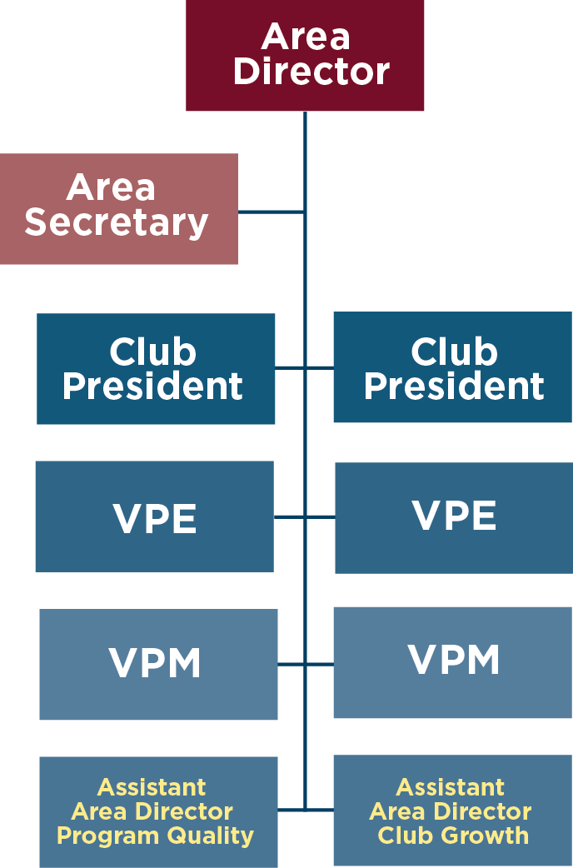
Area Team
Area Director leads council to support area goals
Area Council: Assistant Area Directors, Area Secretary, club leaders
Area Director chairs Area Council
Area Director may appoint assistance directors

Slide 7
Division Director – Role, Responsibilities
Participate in Training
Supervise, motivate, support Area Directors
Coach, mentor Area Directors
Achieve Distinguished recognition goals
Coordinate, conduct Division speech contests
Report progress to District leaders
Division Council chair
Support
Quality
Progress

Slide 8
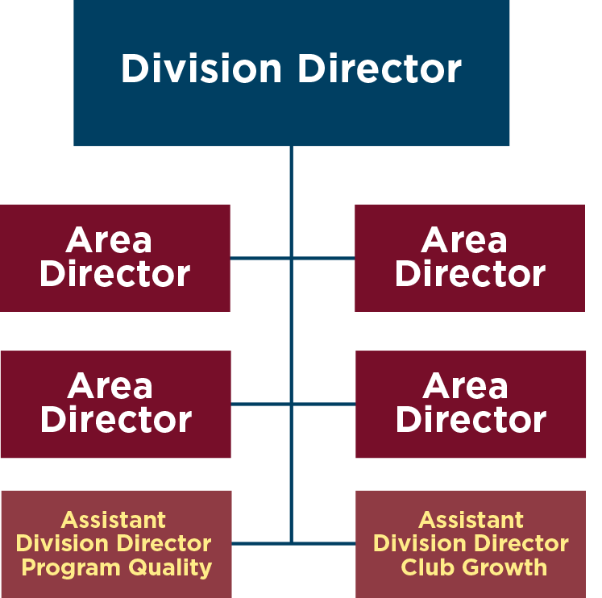
Division Team
Division Director leads council to support division goals
Division Council: Area Directors, assistant directors
Division Director chairs Division Council
Division Director may appoint assistance directors

Slide 9
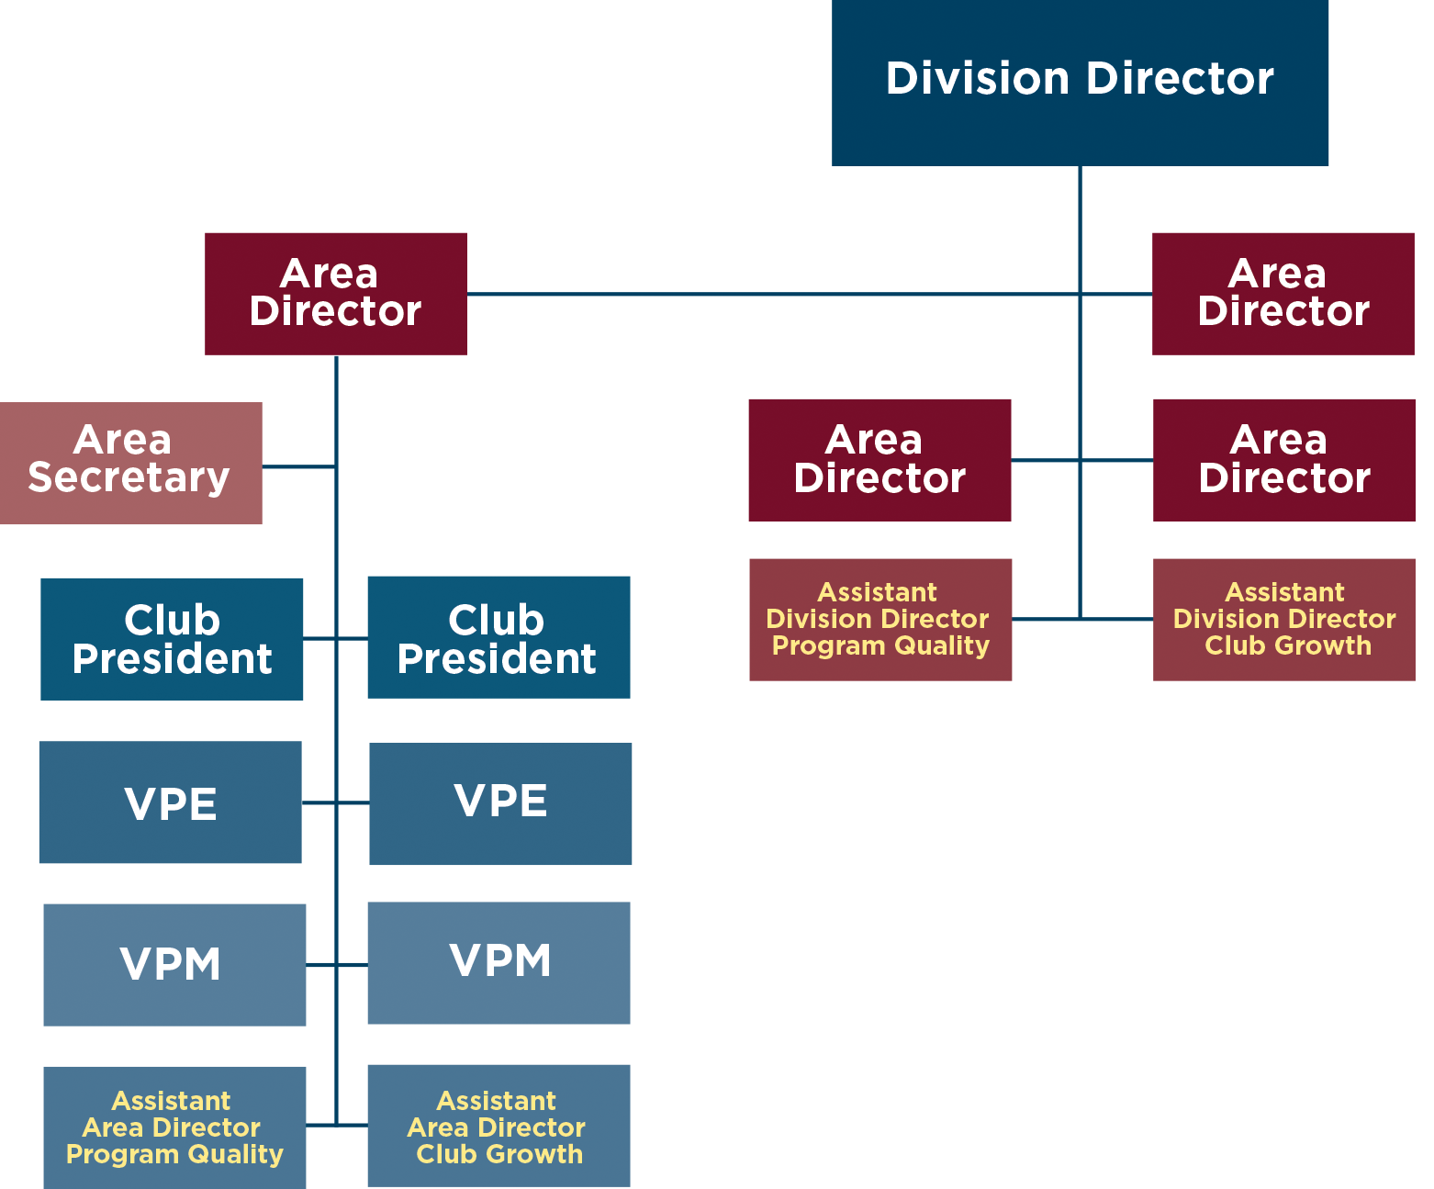
Team Support

Slide 10
Team Agreement
Team Composition
Values
Team Operating Principles
Potential Obstacles
Meeting Protocol
Team Interaction and Behavioral Norms

Slide 11
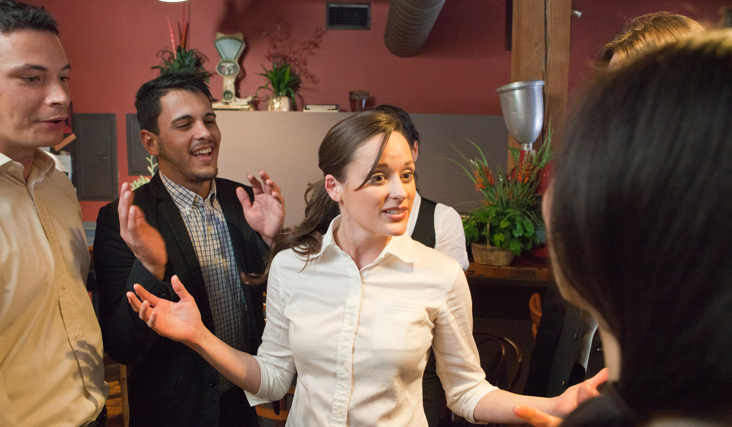

Team Motivation

Slide 12
Five Principles of Motivation
Understanding motivation
Focusing on value
Clarifying expectations
Recognizing your team
Leading by example

Slide 13
Team Conflict Resolution
Talk in private.
Share responsibility and agree to resolve issues.
Present viewpoint in unemotional way.
Determine points of agreement and disagreement.
Decide how to proceed on disagreements.
Summarize discussion in writing and move forward.

Slide 14
Review
Recount roles of Division and Area Directors.
Identify members of Division and Area Councils and ways councils offer support.
Describe a team charter and its benefits.
Build trust and set expectations using team charters.
Apply the Five Principles of Motivation.
Use conflict resolution techniques.

Slide 15
Conclusion: Closing Remarks
Division and Area Directors have many responsibilities.
Division and Area Councils help Division and Area Directors.
Team charters help teams be effective and productive.
Good team leaders employ the Five Principles of Motivation.
Resolving conflict allows teams to be more productive.

